Slide 1
Process to Apply for District/School of Innovation
Dr. Bryan Marshall
Office of Innovation and Support Systems
Fall 2025
Notes:
Good Morning,
We are so excited you are here. This webinar will be recorded.
Would you please put your name and school district in the chat? Thank you
While you do that, I have put three documents into the chat, this PowerPoint, the application and the rubric.

Slide 2
Mississippi Department of Education

Slide 3
State Board of Education STRATEGIC PLAN GOALS
Notes:
The state board of education goals help to provide a roadmap for all districts. If you review these goals you will see that most DOI and SOI touch 5 out of 6 of these. And some touch all six.

Slide 4
Objectives
Understand the application timeline and overall process.
Examine components of the DOI/SOI application and scoring rubric.
Identify common mistakes and pitfalls of the DOI/SOI process.

Slide 5
What is a District/School of Innovation?
Mississippi Code Title 37. Education § 37-179-1. Creation of districts of innovation. Legislation
Expands learning options, accelerates achievements, and improves college and career readiness for all students.
Pilot of innovative models that strive to remove barriers and promote equity.

Slide 6
What is a District/School of Innovation?
Examples of Innovation in Mississippi
K-12 workforce initiatives
Early College High Schools
Flexible Scheduling (Block, hybrid, extended day, etc.)
Industry Partnerships that provide externships
Project SEARCH
Career Academies tied to workforce pipelines
Virtual/dual enrollment models

Slide 7
Current Districts of Innovation
Booneville School District Corinth School District Grenada School District Gulfport School District Hinds County School District Oxford School District Pascagoula-Gautier School District Starkville Oktibbeha School District Tupelo School District Vicksburg Warren School District

Slide 8
Current Schools of Innovation
Schools of Innovation Mannsdale Upper Elementary School (Madison County School District) Meridian High School Mississippi School for Mathematics and Science Mississippi School of the Arts New Albany Middle School Pontotoc High School Richland High School
Early College High Schools Golden Triangle ECHS Natchez ECHS River City ECHS Jackson Public Schools ECHS
Middle College High School Programs George County Collegiate Academy MCHSP Harrison County Collegiate Academy MCHSP Hattiesburg High School MCHSP Jackson Public Schools MCHSP Kosciusko High School MCHSP Laurel High School MCHSP Petal High School Bridge Program MCHSP Western Line School District MCHSP -O’Bannon High School -Riverside High School

Slide 9
Application Process

Slide 10
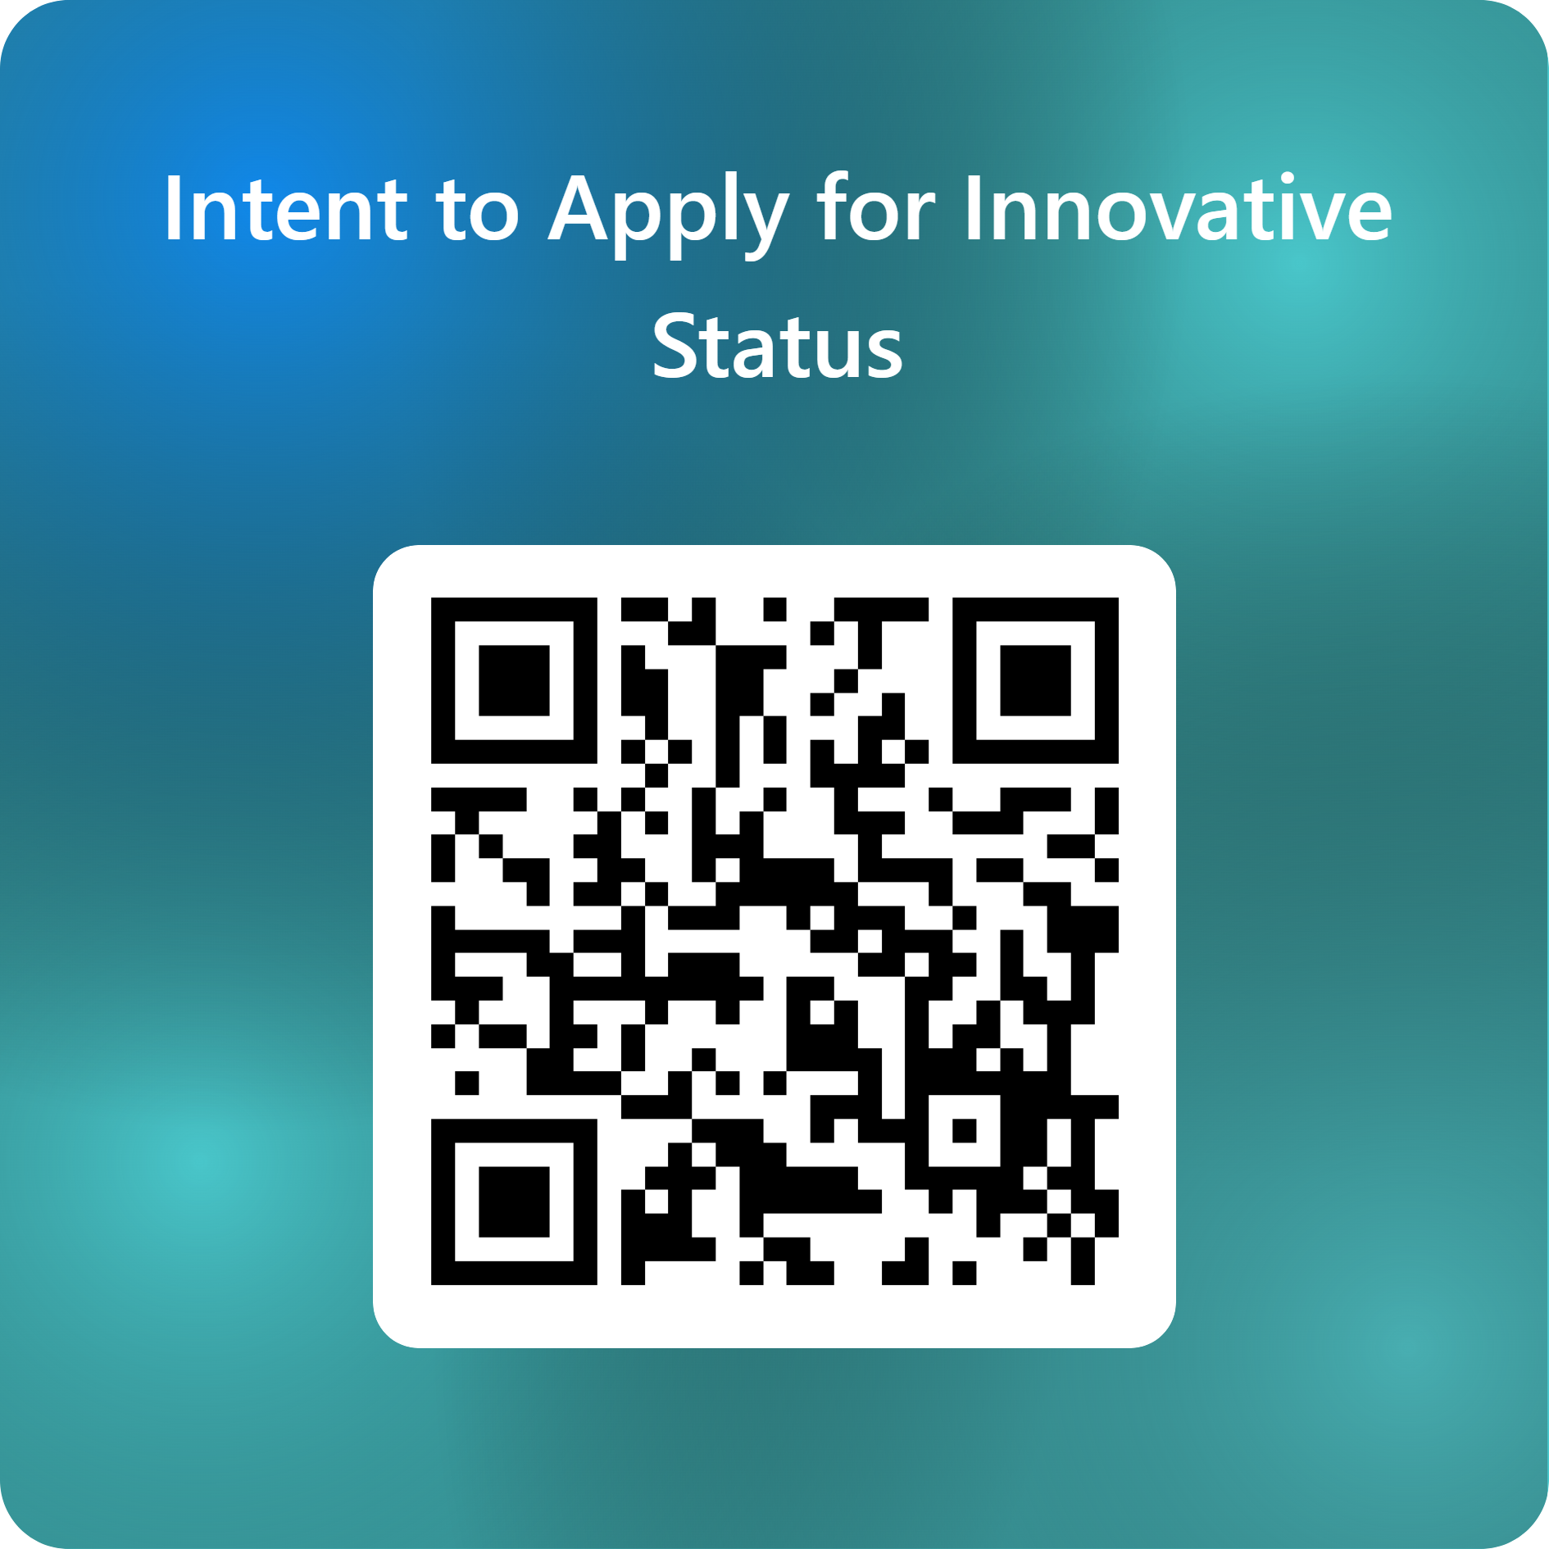
Fall 2025 District/School Of Innovation Application Process
Schools and/or districts need to complete and submit an “Intent to Apply” form using the link or QR code below
https://tinyurl.com/InnovateMS2025
Notes:
https://forms.office.com/r/Nq9uwz25M5
If you are intending to apply this year. Please complete this form. A registration link will be sent to register for one of the face-to-face trainings.

Slide 11
Fall 2025 District/School Of Innovation Application Process
Districts or schools who intend to apply will need to attend one of the following face-to-face training dates with their team:
October 27th – 9:00 am-12:30 pm
Madison County School District Central Office
476 Highland Colony Parkway
Madison, MS
November 10th – 9:00 am-12:30 pm
Mississippi State University Research and Curriculum Unit
103 Russell Street
Starkville, MS
December 1st – submit final application

Slide 12
Phase 1: Review of Application
The application and scoring rubric can be found on MDE’s District and School of Innovation page here.
December-January: All submitted applications are reviewed.
The review committee will consist of:
A peer from a current DOI/SOI
MDE Experts
RCU staff

Slide 13
Phase 2: Interview
All applications that meet the minimum score are sent to Phase 2.
Interviews may be virtual or face-to-face as needed.
Each district or school asked to be part of Phase 2 should plan to have present at the interview:
Application contact person
Superintendent
Administration
Teacher Representatives
Community Partners, etc.
Notes:
Minimum Acceptable Points for Consideration of Innovative Status:
Elementary or Middle School of Innovation: 63/93
Career Academies:70/104
High School or DOI: 65/97
Will last no more than one hour.

Slide 14
Phase 3: Executive Leadership Review
Applications that pass Phase 2 are then sent to the MDE Executive Leadership Team (ELT).
ELT can approve or deny any application.
Waivers will be reviewed and either approved or denied.
ELT approved applications are submitted to the State Board of Education for final approval.
Districts/schools will be notified in writing (email) when their application is approved.
Notes:
Will this still be the process?

Slide 15
Phase 4: State Board of Education Approval
Approved applicants with their list of approved waivers are sent to the SBE for final approval.

Slide 16
Application and Rubric Overview

Slide 17
Application Review Tips
Consider your plan.
Will this plan only involve 1 school in the district?
Will this plan involve all students K-12?
Will this plan include a career academy, early college high school or middle college program?
If applying as a district, K-12 and the career technical center needs to be included.
Answers to the above will determine the focus of your application and how the plan is scored on the rubric.

Slide 18
Application Review
Front matter
Pages 1-8 consist of instructions for applying and are for your use only.
Application begins on page 9.
Please do not send pages 1-8 with your application.
Notes:
Application Submission Guidelines
3
Application Guidelines
4
Purpose of a District of Innovation or School of Innovation
4
Definitions
4
Waivers and Exemptions
6
Application Plan – Approval, Amendment, and Revocation Process
6

Slide 19
Application Review
Page 9 Cover page of application.
Page 10 Assurances –must be signed. Applications without a signed Assurances page will not be reviewed.
Pages 11-14 contain the components of the application that must be completed in full.
Notes:
May want to switch to the application and show.

Slide 20
Application Review
Component 1 Mission and Goals
A- Mission and Goals should focus on the following:
college and career readiness, student aspirations, measurable student achievement, and a strong dedication to promoting equity.
B- What challenges and barriers will the innovative plan address?
If a district is applying, the above must include K-12 and the career technical centers.

Slide 21
Application Review
Component 2 Innovative Program Design and Structure
Must state how the innovative plan will differ from a traditional approach.
Explain in detail how the plan will be promoted and communicated to and with all stakeholders.
How will students be supported in the innovative plan?
Student selection process (if applicable).
Career Academy - cross-grade articulation.

Slide 22
Application Review
Component 3 Support for Innovation
Who supports the innovative plan?
Provide letters of support from all stakeholders
What will support the innovative plan?
What instructional materials or resources will be needed for the innovative plan?
How will the innovative plan be supported financially?
A 5-year financial breakdown must be included.

Slide 23
Application Review
Component 4 Staffing
Provide the list of key district/staff who will be a part of the innovative plan.
Component 5 Professional Development
What professional development will be needed to train and provide knowledge of the innovative plan?
Career Academy- Teacher externships and industry partners need to be provided.

Slide 24
Application Review
Component 7 Innovative Teaching and Leading
Detailed description of activities beyond the normal school experience such as extracurricular, exploratory, PBL, etc.
Career Academy- Provide information on any external standards that will be used.
Detail how ISPs will be utilized within the innovative plan.
Detail how accelerated courses/programs will be offered and accessible for all students.

Slide 25
Application Review
Component 8 Stakeholder Collaboration
Who are the community stakeholders/industry partners?
Career Academy- What work-based learning opportunities will be available?
Component 9 Annual Reporting of Performance Measures
Determine what the annual performance targets/goals are that will support the vision and mission of the innovative plan.
Explain how the performance targets will be achieved by providing specific, measurable projections of growth and progress for each year within the five-year approval period.
Data on the above will be requested each year from the MDE.

Slide 26
Application Review
Component 10 Sustainability
How will the innovative plan be evaluated for effectiveness?
Component 11 Waivers and Exemptions
Be sure to include the exact item you are requesting a waiver from.
Complete and include the waiver table.
Remember there are no waivers possible for state testing or awarding of letter grades to districts.
Be prepared to implement your plan without the requested waivers.

Slide 27
Application Review
Component 12 Timeline of Activities
Innovative plan includes a full timeline of activities during the development, implementation, and possible activities that will take place to ensure the sustainability of the innovative plan.

Slide 28
Application Review
Component 13 Data Sharing Agreement
Data will be provided each year to all stakeholders on the success of the innovative plan.
Data will be provided to the MDE annually on progress towards meeting the goals of the innovative plan.

Slide 29

Questions

Slide 30
Bryan Marshall, Ph.D.
bmarshall@mdek12.org

