Slide 1
Office of Secondary Education
Revisions to State Board Policy and MS Public and Non-Public School Accountability Standards, 2024
Wendy Clemons
Chief Academic Officer
May 2025

Slide 2

MS Public School Accountability Standards, 2025
Dr. Lance Evans and Dr. Paula Vanderford
Heather Morrison, Director of P-20
Office of Secondary Education
Office of Career and Technical Education
Office of Accreditation

Slide 3
Mississippi Department of Education

Slide 4
State Board of Education STRATEGIC PLAN GOALS

Slide 5

Readopted ELA and Math Standards for 2025-2026
2025 MS CCRS for English Language Arts and Mathematics
Draft of the accessible version of 2025 MS CCRS will be up by the end of the week on secondary curriculum pages.
Finalizing accessible version to be released on MDE website soon
2016 CCRS and all associated supporting resources will be removed July 1, 2025
  2016 Scaffolding Documents will be replaced by new resource: 2025 MS CCRS Navigators
  2021 Instructional Planning Guides will be updated to reflect 2025 MS CCRS
https://mdek12.org/secondaryeducation/
Notes:
The 2025 Mississippi College- and Career-Readiness Standards (MS CCRS) for Mathematics and English Language Arts (ELA) are now available
These readopted standards will go into effect beginning with the 2025–2026 school year. Educators are encouraged to begin reviewing and preparing to transition to the 2025 MS CCRS to ensure alignment in planning and instruction.
Please note that the 2016 MS CCRS and all associated supporting resources will be removed on June 30, 2025. This includes:
2016 Scaffolding Documents (to be replaced by the new 2025 MS CCRS Navigator: Comprehensive Support for Instructional Preparation)
2021 Instructional Planning Guides (to be updated to reflect the 2025 MS CCRS)
In addition, the Mississippi Department of Education (MDE) will release an accessible version of the 2025 MS CCRS designed to support ADA-compliant screen readers and other assistive reading technologies. This resource is currently in development and will be made available soon.

Slide 6

EdUpdates Newsletter & Website
The EdUpdate section of the Mississippi Achieves website includes announcements for educators and district leaders about professional development opportunities, events, resources, grants, and awards.
EdUpdate Newsletter email is sent out each Tuesday afternoon to all subscribers.
Visit https://msachieves.mdek12.org/edupdate/ and click Subscribe to EdUpdate – you will be directed to a form to join the mailing list.

Slide 7


College and Career Readiness Platform
Due to ESSER freeze, services provided by the state have been suspended until further word from the United State Department of Education.
MajorClarity by Paper has agreed to continue services through the end of May 2025
If funding is reinstated, state-funded services will resume until December 2025 when the ESSER funding is expended.
Districts may choose to contract and pay locally for a CCR Platform when state funded is no longer available.

Slide 8
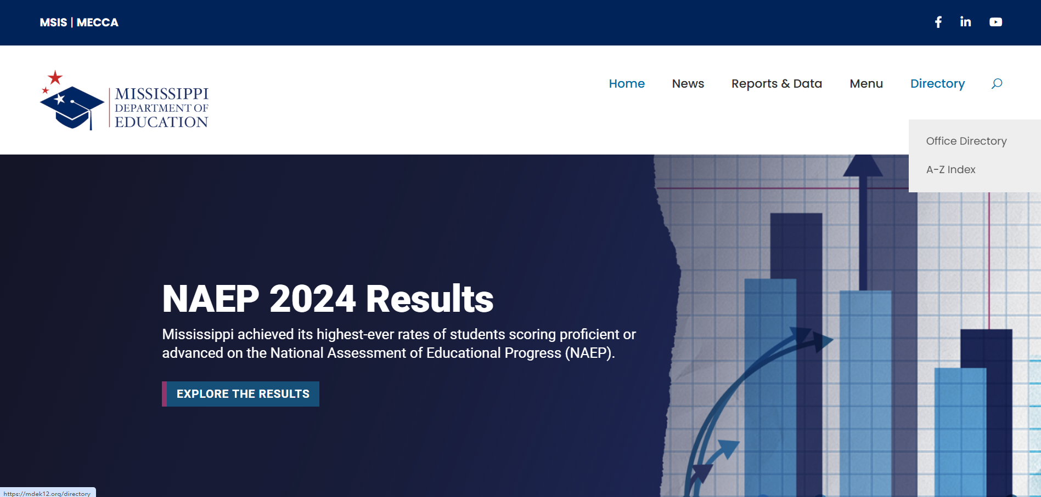

The Approved Courses for Elementary and Secondary Education Portal

Slide 9
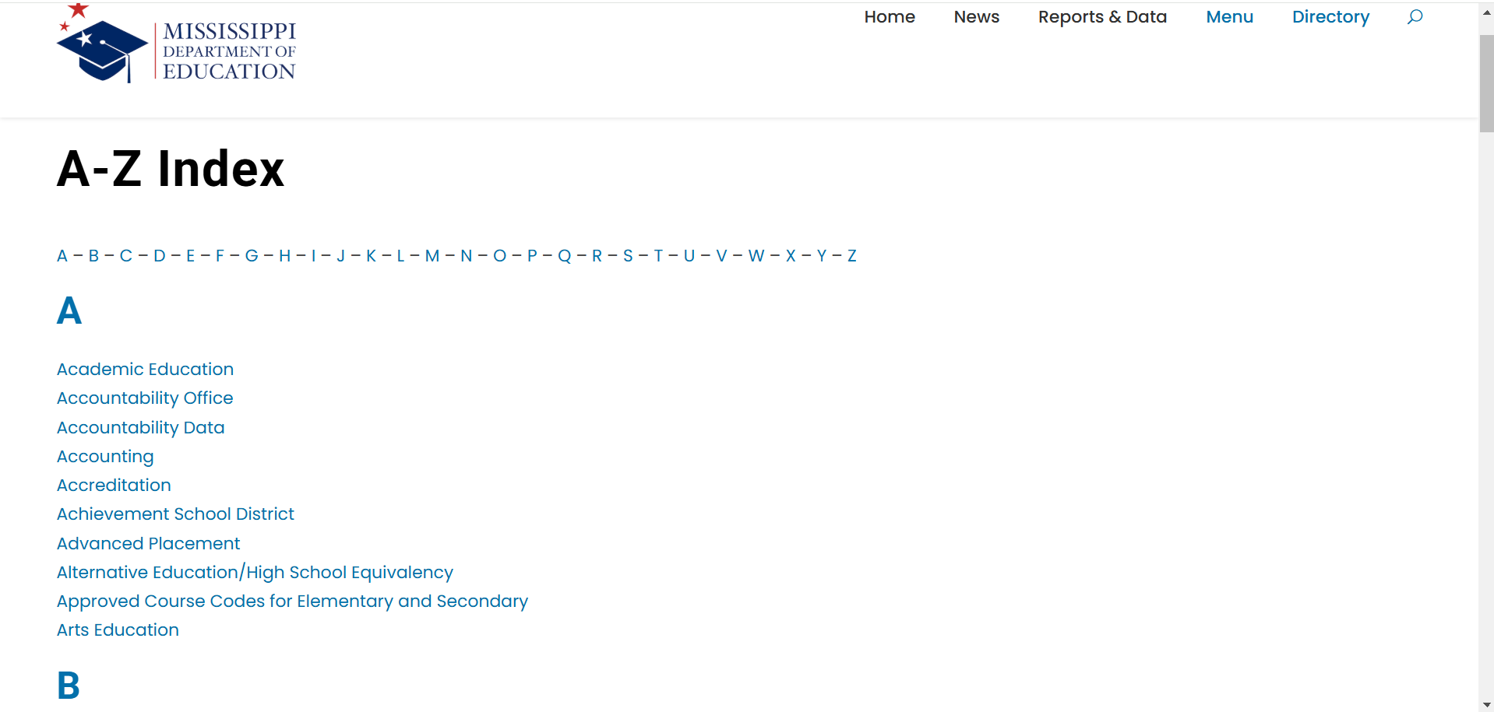
The Approved Courses for Elementary and Secondary Education Portal

Slide 10
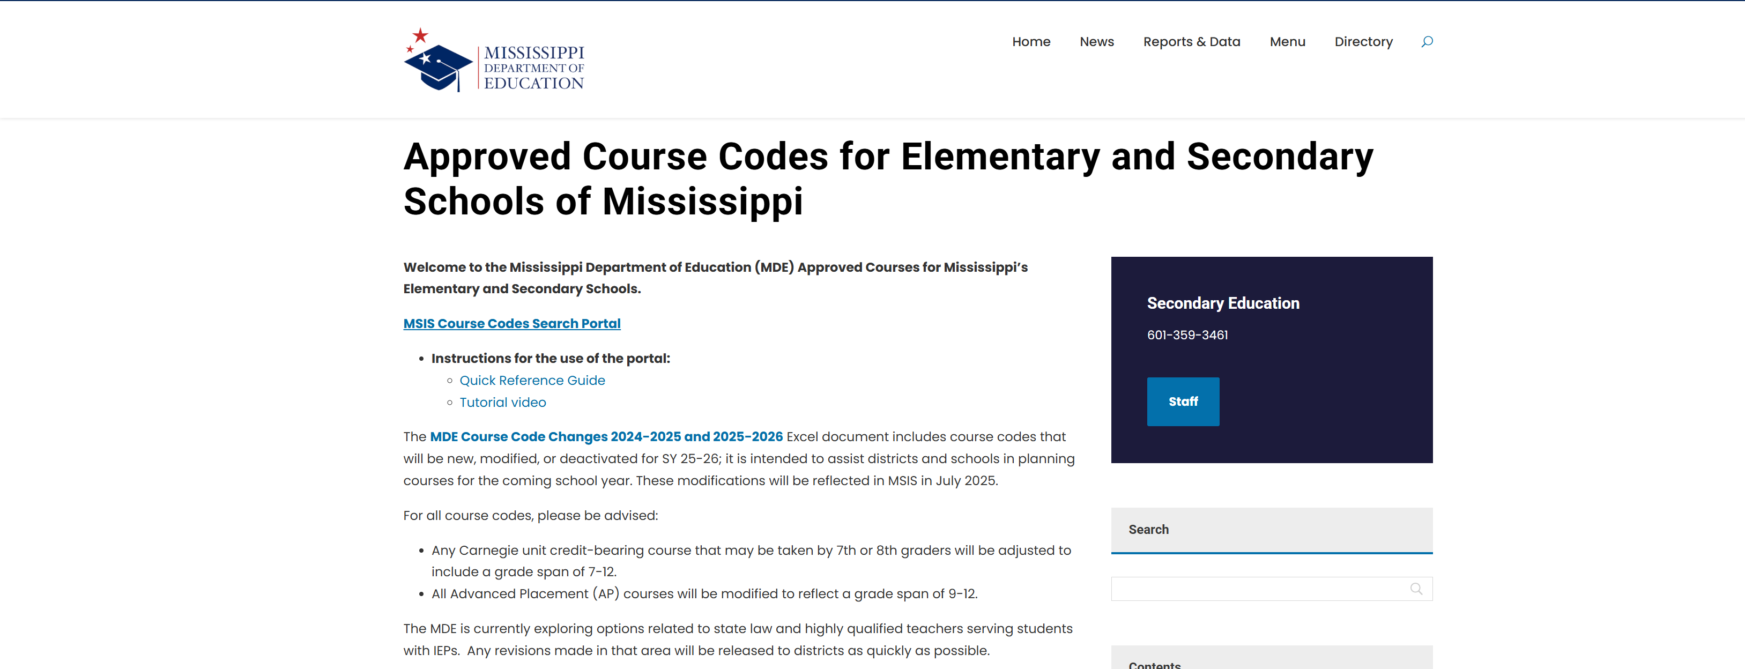

The Approved Courses for Elementary and Secondary Education Portal

Slide 11
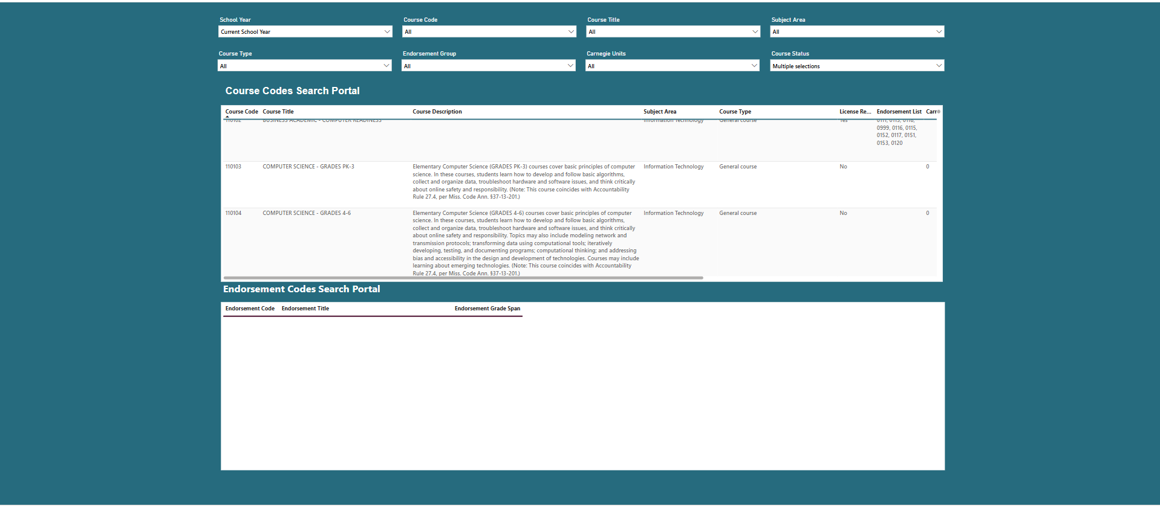
Approved Courses for Elementary and Secondary Education Portal
https://app.powerbi.com/view?r=eyJrIjoiNTdhYzRiYzUtZGYzNS00NzY5LTg4MTAtOTJiMjllNDc0MGYyIiwidCI6IjdlMzViMzQ0LTcxMDYtNDk4Yi05OTgwLTA1MTBhMTMyYjc3NyIsImMiOjF9

Slide 12
The Approved Courses for Elementary and Secondary Education Portal
https://mdek12.org/wp-content/uploads/sites/38/2025/05/MDE-Course-Code-Changes-24-25-and-25-26.xlsx

Slide 13
SECONDARY POLICY REVISIONS

Slide 14

Policy proposals to the State Board of Education in April 2025 for SY 25-26
  Chapter 36, Rule 36.7
  Early Graduation Policy. The purpose of the early graduation policy is to provide guidance to Local Education Agencies (LEAs) with early graduation opportunities.
  Early graduation is defined for this policy as successful completion of all existing standards required by both state and respective district prior to completing eight (8) semesters of high school work from the start of grade 9.
  Comment period closes on May 19, 2025, and the final version will go back to the SBE for final approval on June 19, 2025.

Slide 15
MS Public and Non-Public Accountability Standards, 2025

Slide 16
Secondary Revisions to Appendix A-5 of the MS Public School Accountability Standards
The CPAS exam was removed from Appendix A-5 and clarification was provided for Career Pathways Assessment Blueprint.
Include an additional portfolio and exhibit option in lieu of passing the end-of-course assessment.
  Only the second semester of the senior year of the corresponding ninth-grade cohort.
  The corresponding EOC assessment must have been taken during every available administration.
  Eligibility requirements include attendance, GPA and discipline during the student’s junior and senior years.
  All existing options provided in lieu of EOC currently in Appendix A-5 of the standards must be considered first.
  A set of standards with curricula and scoring rubrics will be written and disseminated to districts for use.
The policy and future standards, curriculum, rubrics and other resources may be accessed at https://mdek12.org/secondaryeducation/bridge-to-career-course/

Slide 17
Additional revisions to the MS Public School Accountability Standards
Clarification in Appendix A-6 through A-9
  Reference to Compensatory changed to Supplemental in ELA and Mathematics
  Reference to Accelerated English 9 and 10 removed
  Note that the Arts includes Dance, Media Arts, Music, Theatre, and Visual Arts
  Dual credit in the CTE/JROTC endorsement may be academic or CTE
  Work-based learning must be credit-bearing
Additions to Appendix A-12 and A-13
  Multimedia as requirement met for Tech, Art or Advanced Elective
  Health Science as requirement met for Science or Advanced Elective
  PLTW Cyber Security substitutes or counts as technology or computer Science credit
  Added a reference to Cambridge and IB meeting tech/computer science credit with MDE Office of Secondary Education approval
Glossary
    Added a definition of Supplemental Course

Slide 18
Questions?

