Slide 1
21st CCLC Pre-Proposal Conference
Porsha Jordan
21st CCLC State Coordinator
Dalphiney Bell
21st CCLC Specialist
June 3, 2025

Slide 2
Mississippi Department of Education

Slide 3
State Board of Education STRATEGIC PLAN GOALS

Slide 4
Microsoft Teams Reminders

Slide 5
Microsoft Teams Reminders
Please mute yourself unless you have a question to reduce background noise
Please cut the camera off to save bandwidth to reduce technical glitches
Please ask questions throughout the presentation via chat

Slide 6
Microsoft Teams Reminders
6
“Raise Hand” Feature

Slide 7
Agenda
General Information
Program Implementation
Grant Award and Responsibilities
Proposal Forms and Attachments
Supplemental Forms and Resources
Non-Award Factors
RFP Review

Slide 8
General Information

Slide 9
General Information
The Nita M. Lowey 21st Century Community Learning Centers (21st CCLC) is a grant program issued by USDE to SEAs Title IV, Part B
Elementary and Secondary Education Act (ESEA) as authorized by Every Student Succeeds Act (ESSA), Section 4201

Slide 10
Program Purpose
The 21st CCLC program purpose is to provide opportunities for academic enrichment activities during non-school hours or periods when school is not in session, such as before or after school, weekends or during the summer, particularly for students who attend low performing schools
The 21st CCLC program offers families opportunities for active and meaningful engagement in their children's education, including opportunities for literacy and related educational development

Slide 11
Eligibility Criteria
Any public or private organization is eligible to apply for a 21st CCLC subgrant. Examples of agencies and organizations eligible under the 21st CCLC program include, but are not limited to:
School Districts (LEAs)
Indian Tribe or Tribal Organizations
Charter Schools
Educational Consortia
Non-profit agencies
Faith or community-based organizations
Institutions for Higher Education
City or County government agencies

Slide 12
Eligibility Criteria
LEAs
School Districts
Indian Tribe or Tribal Organizations
Charter Schools
Non-LEAs
Educational Consortia
Non-profit agencies
Faith or community-based organizations
Institutions for Higher Education
City or County government agencies

Slide 13
Eligibility Criteria
At the time of award, grant applicants are allowed to operate no more than two 21st CCLC grants during the fiscal year (July 1, 2024 – June 30, 2025).
Grant applicants must follow the competitive process for determining new subgrant awards and no special consideration will be given for having received a prior subgrant.
Any 21st CCLC subgrants that have been terminated by the MDE for violations of non-compliance are not eligible to reapply for three (3) consecutive fiscal years from the effective date of termination

Slide 14
Eligibility Criteria
Applicants that previously received a subgrant award must be in good standing with the MDE to receive an award through this solicitation. If applicable, Subgrantees must have previously submitted:
any final evaluation reports and data as required;
any annual performance reporting data;
finalized all monitoring review corrective actions;
any requests for reimbursement of allowable expenditures following MDE’s reimbursement process; and
the Year-End Budget Report.

Slide 15
Unique Entity ID (UEI) Requirement/SAM
The UEI number is a unique number used to identify Subgrantees. The federal government uses the UEI to track how federal money is allocated to Subgrantees. All Subgrantees must have an active UEI Number, that is unrestricted and accessible at www.sam.gov. Please visit Guide to Getting a Unique Entity ID for more information.
To receive a UEI Number, you must register with the System Award Management (SAM). Any debarred person or Applicant will not be eligible to apply and receive Federal funds.
Verification and documentation of the registered active UEI must be submitted with the proposal

Slide 16
SAM Registration
Go to the SAM website: www.sam.gov
Click on Sign In
Select "Create an account" and enter your email address.
Registration for www.sam.gov is completely free of charge. There is no fee for you to register or renew/update your organization's information.

Slide 17
Official Subgrantee
Proposals may be submitted jointly by a variety of agencies and organizations. However, please note that only one organization must be designated as the fiscal agent.
Proposals submitted jointly must complete the Co-applicant/Consortium Forms (Form #11 & #12).

Slide 18
Sustainability
Matching Funds, which include State, Federal, Private, and other alternative funding, are not required to apply for the 21st CCLC subgrant; however, a formal sustainability plan is a requirement of the 21st CCLC program

Slide 19
Program Implementation

Slide 20
Program Activities:
Applicants receiving an award are responsible for utilizing these funds to carry out activities that advance student achievement and support student success, including but not limited to:
Academic Enrichment Learning Programs, mentoring programs, remedial education activities and tutoring services
Literacy Education Programs
Programs that support a healthy and active lifestyle, including nutritional education and regular, structured physical activity programs, and recreational activities;

Slide 21
Program Activities
Services for individuals with disabilities
Cultural Programs
Telecommunications and technology education programs
Expanded library service hours
Drug and violence Prevention programs
Programs that build skills in science, technology, engineering, and mathematics (STEM)
Expanded learning programs that provide students at least 300 additional program hours before or after the traditional school day and/or during the summer.

Slide 22
Equitable Participation of Private, Non Public-School Students
Applicants must conduct timely and meaningful consultation with private and non-public school officials during the design and development of the 21st CCLC program on issues such as how the children's needs will be identified and what services will be offered
Private School Consultation Form (Form 6) must be completed and submitted by all applicants.

Slide 23
Program Reports and Evaluation
What is the evaluation report? The evaluation report is an essential element of the program’s ongoing planning, design, and implementation.
Subgrantees will be required to prepare and submit an end-of- year evaluation report each year.
Evaluator addresses specific targets that will enable the subgrantee to make informed decisions about changes that the program may need
Required to provide data through the U.S. Department of Education's 21st CCLC Data Collection System (21APR, CAYEN)

Slide 24
Proposal Review and Selection Process
Phase 1 - Review of Proposal Components
Review of proposal to determine if all formatting and submission requirements are met
*It is highly recommended that ALL applicants review the “Required Elements Checklist” on page 68 to ensure the proposal passes Phase 1.

Slide 25
Proposal Review and Selection Process
Phase 2 - Committee Review and Scoring
A Peer Review Committee will evaluate and score each proposal based on the following:
Program Abstract
Quality of Proposed Activities
Evidence provided to demonstrate the capacity of the applicant to implement the proposed program

Slide 26
Competitive Points
After the proposal has met the minimum quality score of 75, competitive priority points will be awarded by the MDE to those applicants meeting additional criteria for competitive priority points.
Review and complete the Competitive Priority Worksheet (Form D) on page 65-67.

Slide 27
Program Abstract
Describe how the community was given notice of the applicant's intent to apply.
How the proposal will be available to the community following its submittal.
Outline the platforms used to ensure reasonable dissemination of applicant's intent to apply as well as the process used to make the proposal available.

Slide 28
Scoring
Needs Assessment (20 Total Points)
The Process (4 points)
Specific Needs (10 points)
Program Focus (6 points)

Slide 29
Scoring
Program Plan and Implementation (42 Total Points)
Program Plan (20 points)
Quality Contact Time (5 points)
Recruitment and Retention (6 points)
Staffing and Professional Development (6 points)
Advisory Council and Operating Partnerships (5 points)

Slide 30
Scoring
Program Plan and Implementation (38 Total Points)
Collaboration and Communications (6 points)
Student Safety & Transportation (6 points)
Sustainability Plan (6 points)
Evaluation (10 points)
Budget (10 points)

Slide 31
Grant Award and Responsibilities

Slide 32
Grant Period and Award Amounts
Grants for eligible organizations will range from $50,000-$400,000 per year
Recipients will receive funding up to 100% for all four (4) years of the grant, pending congressional appropriations.
Funds are subject to appropriation by the Federal Government
The approved grant period of 4 years is contingent upon the availability of continued funding, evidence of documented progress, increased student achievement, and adherence to the annual Program Assurances

Slide 33
Award Amounts
The MDE reserves the right to negotiate grant award amounts with all grantees.
Programs must be operational within 30 days of the MDE award notification or within eight weeks from the first day of school, whichever is later

Slide 34
Use Of Funds
All applicants MUST meet the following requirements:
A maximum of 20% of each year's budget can be allocated for activities related to administration of the 21st CCLC subgrant.
Indirect cost is considered an administrative expense
Evaluation cost is also considered an administrative expense
Evaluator’s cost cannot exceed 2% of the total allocation.

Slide 35
Carryover Procedure
The MDE will collect all unobligated 21st CCLC funds at the end of the initial grant period and redistribute them to other participating subgrantees, provided that each subgrantee is making substantial progress, which is measured by multiple measures of success (i.e. student achievement) in implementing its 21st CCLC program.

Slide 36
Fiscal Requirements
21st CCLC is a reimbursement only grant, meaning all subgrantees must initially expend their own funds prior to receiving reimbursement from the MDE

Slide 37
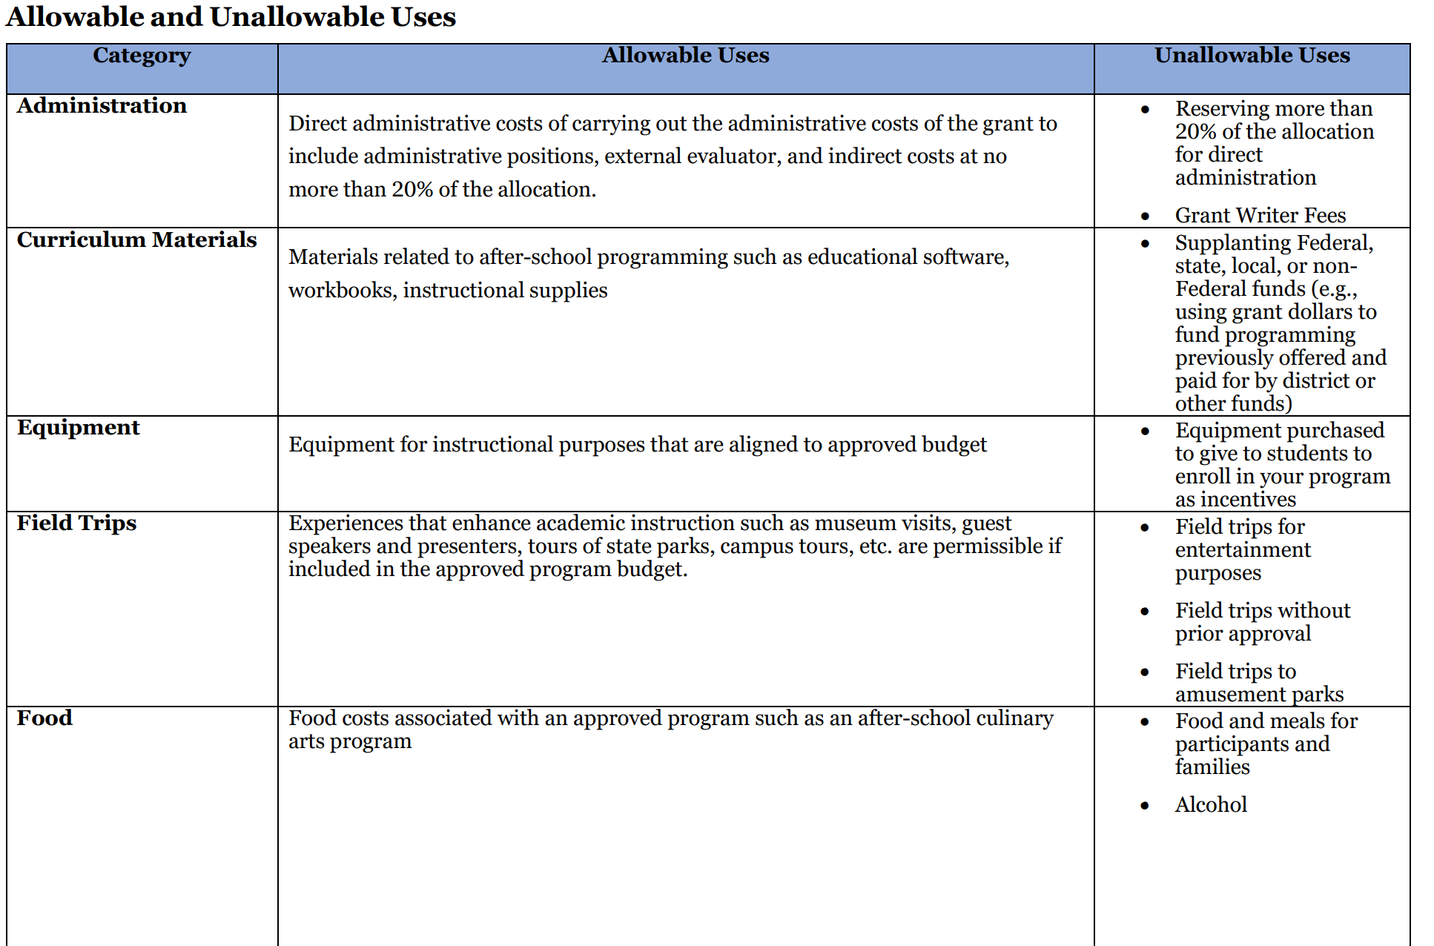
Allowable Use of Funds

Slide 38
Allowable Use of Funds

Slide 39
Responsibilities of a Fiscal Agent
Ensure all awards are adopted by the Local Board of Education for LEAs or the Board of Directors for non-LEAs
Administer the sub grant from award to closeout in accordance with all applicable laws and regulations
Serve as the organizational representative and point of contact for all business management aspects of the award agreement
Apply approapriate management controls using management systems, checklist and records

Slide 40
Responsibilities of a Fiscal Agent
Assemble appropriate staff resources and communicate compliance requirements and resources to the subgrant
1
Keep abreast of changes in policies, procedures or requirements and continue to advise program staff of subgrant requirements
2
Submit reimbursement request no later than the 12th of each month
3
Prepare necessary reports
4
Use feedback from site visits by the MDE to enhance the program, show orgnanizational strenght, and demonstrate commitment to the project.
5

Slide 41
Audit
Any non-federal entity that expends $1,000,000 or more in a year in federal awards shall have a single or program specific audit conducted for that year in accordance with the provisions of 2 C.F.R. Part 200 Subpart F.
If the non-federal entity did not expend $1,000,000 or more in a year in federal awards, a letter MUST be provided stating that this requirement does not apply.
All applicants must complete section 18 of the Program Specific Assurances (Form 4).

Slide 42
Important Dates
June 6, 2025 - Deadline for Submitting questions to 21century@mdek12.org
June 11, 2025 - Questions will be posted to the MDE website
June 30, 2025 - Deadline for Proposal Submission by 2:00 p.m. CST

Slide 43
Submission and Delivery
A signed proposal packet shall be submitted electronically in a PDF format via RFXS no later than Monday, June 30, 2025, by 2:00 p.m. Central Standard Time (CST).
Proposals received after the time designated in the solicitation shall be considered late and shall not be considered for an award.
The subject line shall specify the name of the solicitation and the name of the entity submitting the response.

Slide 44
Submission and Delivery
OR
An original signed proposal packet with number (1) copy shall be shipped/mailed and received in a sealed envelope at the MDE no later than Monday, June 30, 2025 by 2:00 p.m. Central Standard Time (CST).
The return address label must be visible on the sealed envelope and include the name of the individual/entity submitting a response.

Slide 45
Submission and Delivery
Timely submission of the proposal package is the sole responsibility of the Applicant.
Any proposal shipped or mailed MUST be verified, date and time stamped, and recorded by an MDE mailroom staff.
Packages that are delivered at the MDE in person by the applicant or a representative will NOT be opened. Packages received by shipping/mail without the appropriate acceptance by the MDE mailroom staff or is received and recorded AFTER the submission deadline will NOT be considered for an award.

Slide 46
Proposal Forms & Attachments

Slide 47
Proposal Forms and Attachments - LEAs
Proposal Cover Page (Form 1) (Required Signature(s))
Assurances (Form 2) (Required Signature(s))
Standard Terms and Conditions (Form 3) (Required Signature)
Program Specific Assurances (Form 4) (Section 18 MUST be completed & Required Signature)
Conflict of Interest Disclosure Form (Form 5) (Required Signature)
Private School Consultation (Form 6) (Required Signature)

Slide 48
Proposal Forms and Attachments - LEAs
Summary of Partners Table (Form 9)
Signed Partner Letter (Form 10) (Required Signature)
Co-Applicant/Consortium (Form 11)
Co-Applicant/Consortium Letter (Form 12) (Signed if applicable)
Acknowledgement of Amendments (Form 13) (Required Signature)
Verification of UEI (Form 14)
Competitive Priority Worksheet (Form D)

Slide 49
Proposal Narrative
Program Plan
Program Abstract
Needs Assessment
Program Plan
Quality Contact Time
Recruitment and Retention

Slide 50
Proposal Narrative
Program Plan Cont’d
Staffing and Professional Development
Advisory Council and Operating Partnership
Collaboration and Communication
Student Safety and Transportation
Sustainability Plan
Evaluation Plan

Slide 51
Proposal Narrative
Program Plan Cont’d
Budget Form A-Budget Overview
Budget Form B-Budget Summary
Budget Form C-Budget Narrative

Slide 52
Proposal Forms and Attachments – Non-LEA
Each of the forms below must be included in the proposal:
Proposal Cover Page (Form 1) (Required Signature(s))
Assurances (Form 2) (Required Signature(s))
Standard Terms and Conditions (Form 3) (Required Signature)
Program Specific Assurances (Form 4) (Section 18 MUST be completed & Required Signature)
Conflict of Interest Disclosure Form (Form 5) (Required Signature)
Private School Consultation (Form 6) (Required Signature)
Signed Participation Letter(s) (Form 7 & 8)- (Required Signature(s))

Slide 53
Proposal Forms and Attachments
Participation Letter (Form 7 and Form 8) (Required Signature)
Participation letters are required from both the LEA and school
Superintendent must sign the LEA Participation Letter (Form 7)
School Principal must sign the School Participation Letter (Form 8)
Must include a participation letter (Form 8) from each school listed on the Cover Page (Form 1)

Slide 54
Proposal Forms and Attachments
Summary of Partners Table (Form 9)
Signed Partner Letter (Form 10) (Required Signature)
Co-Applicant/Consortium (Form 11)
Co-Applicant/Consortium Letter (Form 12) – (Signed if applicable)
Acknowledgement of Amendments (Form 13) (Required Signature)
Verification of UEI (Form 14)
Competitive Priority Worksheet (Form D)

Slide 55
Proposal Narrative
Program Plan
Program Abstract
Needs Assessment
Program Plan
Quality Contact Time
Recruitment and Retention

Slide 56
Proposal Narrative
Program Plan Cont’d
Staffing and Professional Development
Advisory Council and Operating Partnership
Collaboration and Communication
Student Safety and Transportation
Sustainability Plan
Evaluation Plan

Slide 57
Proposal Narrative
Program Plan Cont’d
Budget Form A-Budget Overview
Budget Form B-Budget Summary
Budget Form C-Budget Narrative (Required Signature)

Slide 58
Supplemental Forms & Resources

Slide 59
Supplemental Forms
Supplemental Form A- Competitive Priority Points
Supplemental Form B- Required Elements Checklist
Supplemental Form C- Data Sharing Agreement
Supplemental Form D-Current 21st CCLC Subgrantees by Geographical Location
Supplemental Form E- MDE Office of School Improvement School Designation List

Slide 60
Resources

Slide 61
Resources

Slide 62
Non-Award Factors

Slide 63
Most Common Non-Award Factors
Late Submission
Hyperlink instead of a PDF/Word Document
Missing or Incomplete Forms
Missing Signatures
Missing Participation Letters and/or Partner Letters
Irregularities in the Proposal
Insufficient Narrative Responses

Slide 64
RFP Overview

Slide 66
Questions
All questions regarding the FY26 21st CCLC RFP must be submitted by 5:00 pm, Friday, June 6, 2025
Questions must be submitted to 21century@mdek12.org with subject line “Cohort 9 21st CCLC Question"

Slide 67
Porsha Jordan
21st CCLC State Coordinator
pjordan@mdek12.org
Dalphiney Bell
21st CCLC Specialist
dbell@mdek12.org

