Slide 1
Introduction to Information Technology Planning for State Agencies
www.its.ms.gov

Slide 2
Topics Covered
ITS Statute: Responsibility and authority for planning
Why Plan: Budget, funding, and technology needs
Planning Process: Planning team, program objectives and priorities, and business case
ITS Online Planning System: Requirements and the review and approval process
www.its.ms.gov

Slide 3
ITS Law: Responsibilities and Authority
For legislative information, the MS Code of 1972 can be found at:
https://www.sos.ms.gov/index.php/communications-publications/mississippi-law
Once there, you can search for specific legislation by clicking on:
ITS Statute: Title 25, Chapter 53
Code Sections 25-53-1 through 25-53-191
Code Section 25-53-29 (1) (b) specifically deal with planning: https://www.its.ms.gov/sites/default/files/ServicesPDFs/PlanningLegislation.pdf
www.its.ms.gov

Slide 4
ITS Law: Responsibilities and Authority
By Law, ITS must:
Adopt rules governing the acquisition of all computer and telecom equipment and services
Review all IT procurements by agencies & IHLs for approval (or disapproval)
Note – ITS purview could be removed for legislatively mandated projects
Execute all contracts for IT equipment and services - ITS Executive Director is “contracting agent” for all technology contracts
Advertise competitive specifications for all acquisitions above $75,000 total lifecycle cost and award to the “lowest and best”
www.its.ms.gov

Slide 5
ITS Purview
ITS Purview Includes:
State Agencies
Institutions of Higher Learning
Other political subdivisions (on request) – example:
Cities
Counties
K-12 Schools
Community Colleges
www.its.ms.gov

Slide 6
ITS Board
Role of ITS Board
Hire ITS Executive Director
Set technology direction for state government
Monitor strategic IT projects undertaken by agency and IHL customers
Adopt rules and regulations for fulfilling the procurement and strategic IT oversight charged in ITS legislation
Approve procurements, including exemptions, above the Director Approval Threshold
www.its.ms.gov

Slide 7
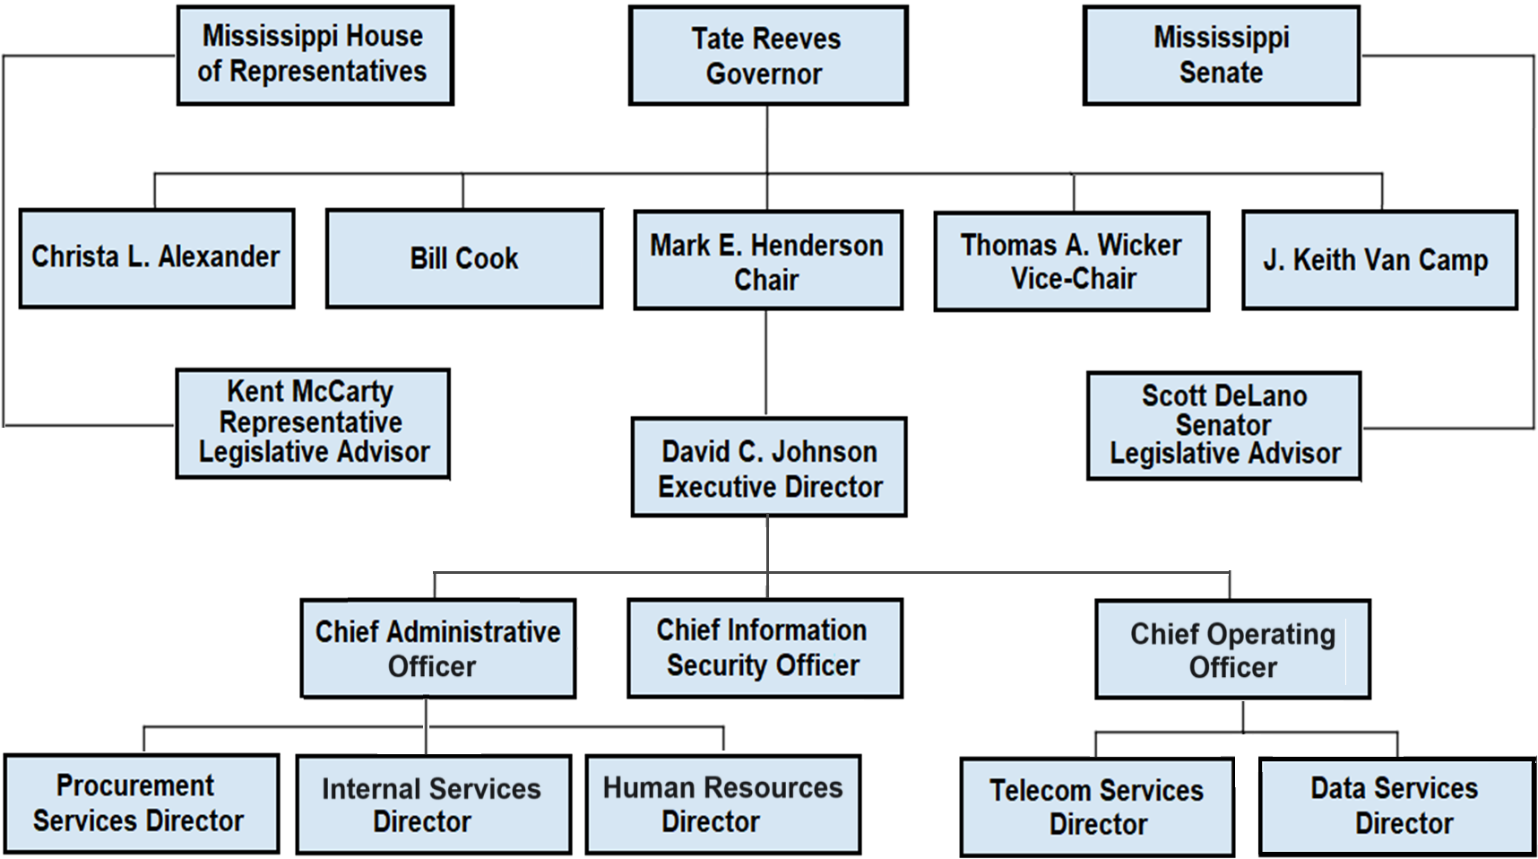
ITS Organization
www.its.ms.gov

Slide 8
Why Plan?
Information Technology (IT) has become increasingly important to the efficient and effective operation of state government.
The planning process provides a method for determining:
How well technology is currently meeting the business needs of the agency
Helps to identify technology gaps and technology that could improve services and performance
The Mississippi State Legislation requires the Mississippi Department of Information Technology Services (ITS) to obtain, review, and approve IT plans which include current and proposed IT projects along with their associated costs.
www.its.ms.gov

Slide 9
What does ITS do with the information?
IT plans are collected and reviewed, then the information is compiled into reports that are evaluated for:
Statewide infrastructure impact and needs
Projects within the plan that could take advantage of volume purchase agreements
IT training and education opportunities
Consulting service requests
The information from the IT plans is also used in the State’s Strategic Master Plan for Information Technology presented annually to the Governor and Legislature to assist them in allocating fiscal resources to best achieve statewide IT goals.
www.its.ms.gov

Slide 10
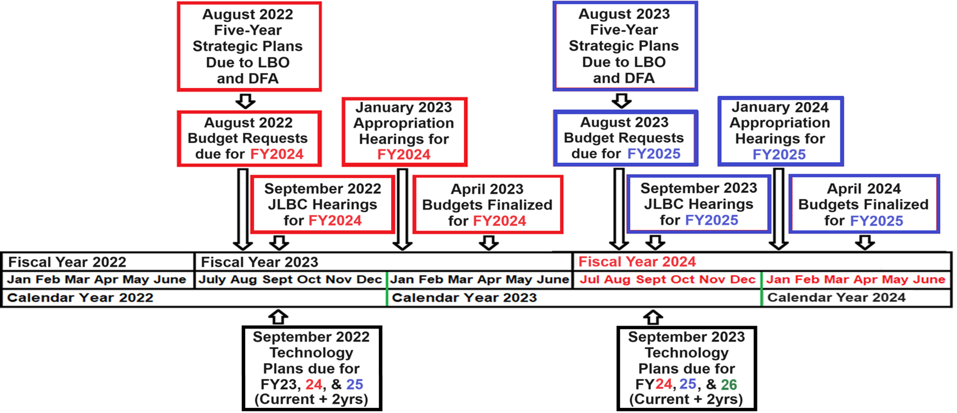
The Budget and Planning Cycle
www.its.ms.gov

Slide 11
Steps to IT Planning
Step One - Establish an IT Planning Team
Designate an IT planner to coordinate plan activities
Involve senior management
Agency Director, Finance Director, Human Resources Representative, Internal Auditor, Chief Administrative Officer
Review the organizational chart to establish a steering committee
Division Directors and/or Program Managers
IT Project Managers
www.its.ms.gov

Slide 12
Steps to IT Planning
Step Two – Review Agency Strategic Information
Review the Agency’s Mission Statement
Example - The Mississippi State Department of Health's mission is to protect and advance the health, well-being and safety of everyone in Mississippi.
Review the Agency’s Five-Year Strategic Plan
Strategies, goals, and objectives of the Program Areas that support the mission of the agency, including Administration
Review all existing software applications and technology hardware supporting mission critical systems
Identify or define technology resources required to support goals
Program area technical staff
IT Project Managers and technical support staff
www.its.ms.gov

Slide 13
Steps to IT Planning
Step Three – Identify Opportunities for Improvement
Example - MSDH Program: Health Services
Sub-Program: Maternal and Child Health
Goal: Reduce maternal and infant mortality, morbidity, and low birthweight through prenatal and postnatal care; provide assistance to children with special health care needs; and minimize the effects of genetic disorders through early detection and timely medical evaluation, diagnosis, and treatment.
Supporting Technology Project:
Replace Access database with integrated system for Child Health
The new system will include an integration of the Newborn Metabolic Screening, Newborn Hearing Screening, and Birth Defects Registry databases.
www.its.ms.gov

Slide 14
Steps to IT Planning
Cost and Resources
License fees – How many years? What are the contract terms?
Implementation cost – How long will the implementation take?
System interfaces – Which other systems need to be modified to interface?
Ongoing vendor support – What are the total annual fees?
Training on new system or hardware – Train the trainer?
Infrastructure – State Data Center(s) hosting, cloud computing, business resilience, ongoing maintenance, operating system license fees, or ongoing vendor fees if hosting with the vendor?
Internal support – Engage the IT System Administrator and/or Project Manager.
www.its.ms.gov

Slide 15
Steps to IT Planning
Agency-wide projects that should be considered
End-users Refresh Cycle - desktops, laptops, and printers
Ongoing License and Maintenance - fees for recurring organization hardware and software charges
Data Capacity Expansion – colocation, cloud storage, and business resiliency
Security Assessment - network vulnerability with risk assessment and penetration tests
Local Area Network Refresh Cycle - routers, switches, and fiber
Communication – phones, smart devices, and video-conferencing
End-user/Staff Technical Training – new applications and staff development
www.its.ms.gov

Slide 16
Steps to IT Planning
Step Four – Establish Priorities for Projects
How important is the project to the mission of the agency?
The Mississippi State Department of Health's mission is to protect and advance the health, well-being and safety of everyone in Mississippi.
Goal A: Reduce maternal and infant mortality, morbidity, and low birthweight through prenatal and postnatal care
What priority is the project to Senior Management?
What is the value based on the cost to benefit ratio?
Step Five – Prepare the Agency IT Plan
Prepare or create an IT Project for each new, in-progress, or planned project, including one for on-going operating costs
www.its.ms.gov

Slide 17
Steps to IT Planning
Step Six – Electronically Submit the IT Plan to ITS
Plans are due by September 1 of each calendar year
The IT Planning System is a web-based application, available to all Agency Planners.
The URL for the system is: https://techplan.its.ms.gov
Agency Planners should contact ITS for system access and training on the application.
The ITS Planning staff is available to provide technology planning assistance and training at no cost.
www.its.ms.gov

Slide 18
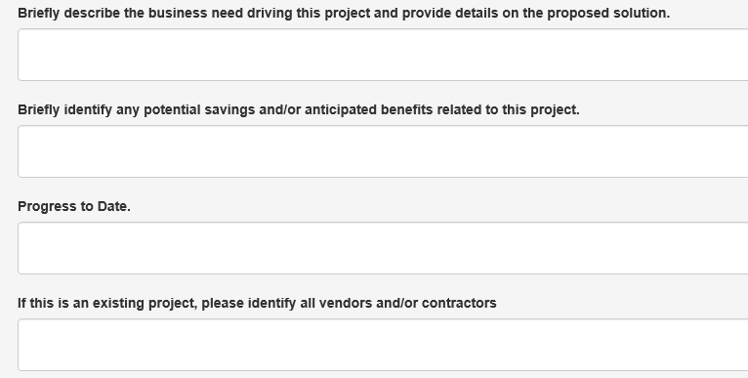
TechPlan - The IT Planning System
www.its.ms.gov

Slide 19
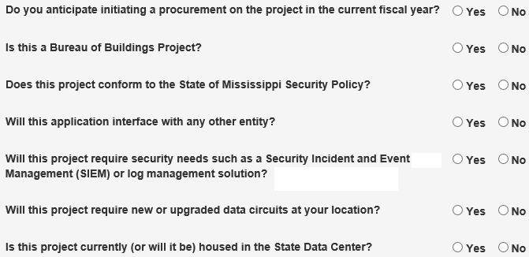
TechPlan - The IT Planning System
www.its.ms.gov

Slide 20
TechPlan - The IT Planning System
Security and Disaster Recovery Planning
Does your agency have a current agency specific IT Security Policy?
When was your agency’s most recent third-party IT Security Assessment?
Who is your agency’s designated IT Security Officer?
Has your agency implemented a Security Awareness Program?
Does your agency have a current IT Disaster Recovery and/or Business Continuity Plan in place?
What was the date of your agency’s most recent IT Disaster Recovery test?
www.its.ms.gov

Slide 21
IT Security Risk Assessment
The State of Mississippi Enterprise Security Policy includes a mandatory requirement for agencies to obtain an IT Security Risk Assessment from a third-party security consultant once every three years.
An IT Security Risk Assessment is considered to be a fundamental process for increasing the security posture of an organization.
For more information, please visit the ITS website’s Security Division page at: https://www.its.ms.gov/services/security.
Or you may email Jay White at jay.white@its.ms.gov or phone at 601-432-8000.
www.its.ms.gov

Slide 22
Projects Requiring ITS Board Approval
The ITS Board is charged in state statute with the responsibility of maximizing the use and benefit of information technology by state agencies, boards, commissions, and public universities.
The ITS Board requires agencies to comply with the following prior to presenting technology projects for approval:
The project must be approved in the agency’s IT Plan
The agency must be in compliance with the State of Mississippi Enterprise Security Policy and have obtained an IT Security Risk Assessment with three years of the presentation to the ITS Board
The agency must submit a completed IT Business Case to accompany the project to the ITS Board for approval
www.its.ms.gov

Slide 23
Business Case
What is a Business Case?
A document that identifies the following:
Reasons for initiating the project including background information
Expected benefits when the project is completed
Critical success factors, risks, assumptions, or dependencies
Impact if the project is not initiated
Funding and project cost estimates
Cost benefit analysis or return on investment include any quantifiable and unquantifiable benefits
Other options considered and why they would not work
www.its.ms.gov

Slide 24
Business Case
A Business Case should support a specific business need of the agency.
Example: A software upgrade might improve system performance, but the business case would describe that “improved system performance” would increase customer satisfaction, require less staff time, or reduce system maintenance costs.
ITS provides Business Case Templates and Workbooks to assist agencies in preparing the required documentation for both IT Projects and IT Consulting Resources (available at the link below).
3
For more information, visit the ITS website under Services, Agency IT Planning at https://www.its.ms.gov/services/planning-agency-it-plans.
www.its.ms.gov

Slide 25
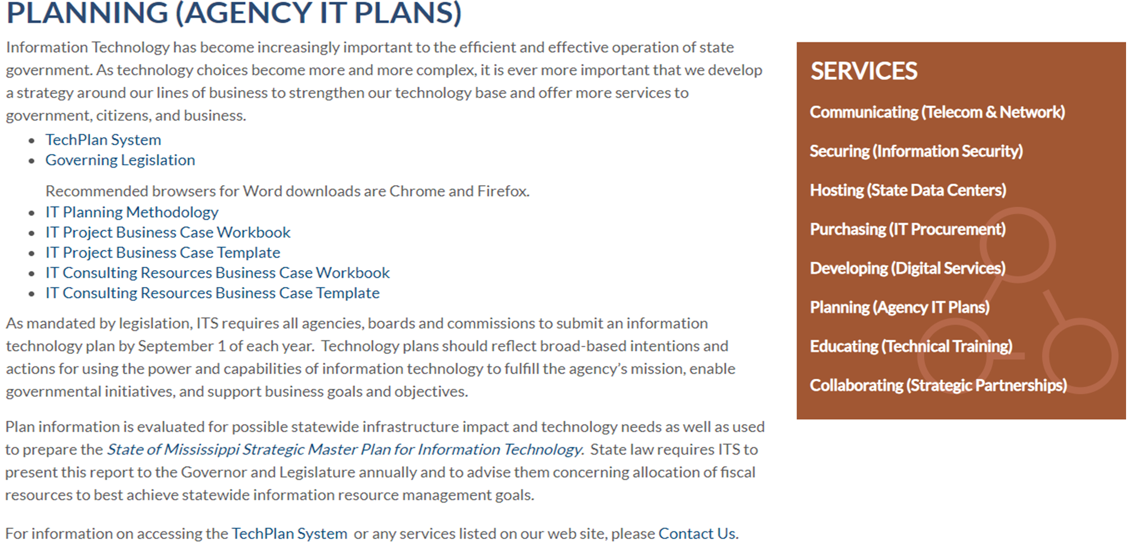
IT Planning Resources
https://www.its.ms.gov/services/planning-agency-it-plans
www.its.ms.gov

Slide 26
Contact ITS
ITS Website http://www.its.ms.gov
Planning (Agency IT Plans)
https://www.its.ms.gov/services/planning-agency-it-plans
Kevin Gray
IT Planning Coordinator (601) 432-8048 kevin.gray@its.ms.gov
www.its.ms.gov

