Slide 1
Implementing Effective P16 Community Engagement Councils
P-16 in Action: Getting Started
October 16, 2019
BoNita L. Harris, PhD
Director of Program Monitoring and Support
Office of School Improvement
Notes:
Good morning and thank you for joining this webinar on today as we look into how schools and districts can effectively implement P16 Community Engagement Councils

Slide 2
Notes:
The Office of School Improvement’s work is always aligned to the vision and mission of the State Board of Education which is to centered around the provision of a world class system for education that prepares the children served in our schools to be successful in all aspects of life. The mission will be carried out through policy and accountability systems.

Slide 3
State Board of Education Goals FIVE-YEAR STRATEGIC PLAN FOR 2016-2020
All Students Proficient and Showing Growth in All Assessed Areas
Every Student Graduates from High School and is Ready for College and Career
Every Child Has Access to a High-Quality Early Childhood Program
Every School Has Effective Teachers and Leaders
Every Community Effectively Uses a World-Class Data System to Improve Student Outcomes
Every School and District is Rated “C” or Higher
Notes:
The context is further clarified through the goals that guide strategies and actions aimed at bringing out improved outcomes, not just for our lowest performing schools, but for all of our schools and districts

Slide 4
Learning Targets
To provide guidance for P16 implementation
To review rules and regulations governing P16 Councils
To review the process for developing a P16 Council
To provide context on roles and responsibilities of the school district/school administration and P16 Council
Notes:
Our goal for today is to provide school and district leaders with the context for effectively implementing a P16 Community Engagement Council. It is my desire to walk you through the stages of the process so that you’re able to effectively implement a P16 Council Council. We will review P16 guidance for newly identified schools based on official 2017 accountability ratings, policies governing P16 councils as well as the roles and responsibilities for schools, districts and P16 members.

Slide 5
P16 Overview
P-16 stands for Pre-Kindergarten through higher education (or year 16 of education)
P-16 Councils are INDEPENDENT groups made up of community members, leaders, and educators
P-16 Councils examine policies and suggests actions to the school district or school administration
P-16 Councils are created based on governance by state law and MS Public School Accountability Standards
Notes:
Before we get into the process of developing/implementing a P16 Council, I want to provide you with some context around it.
#1- Read bullet 1
#2- Read bullet 2- Independent has been highlighted in red. I want to make sure that schools and districts walk away with an understanding councils do not operate under the school district but takes direction from its internal leadership structure.
#3- Read bullet 3- Two key terms to keep in mind are #1- examine (P16 councils look over policy that is already outlined in the district) and #2- suggests (P16 councils propose or introduce an idea for consideration or possible action)
#4- Read bullet 4

Slide 6
Getting Started
Where is your school/district in the process of implementing a P16 Community Engagement Council?
No Development | Beginning | Emerging | Fully Implemented
 | Initial Conversation | Selection of Members | Active P16 Council
Notes:
As we get started, think about where your school/district is in the process of implementing a P16 council.
Is there no development- your school/district has not started the process or engaged in conversations about the council and where to begin
Are you in the beginning stage and have actually engaged in initial conversations about the process and what’s required of the school and/or district
Or have you emerged where conversations have taken place and meetings have occurred and progressed to the selection of P16 members
Or do you have a fully implemented P16 Community Engagement Council

Slide 7
P16 Community Engagement Council Implementation
A school district that has been designated as Failing (F) as defined by the State Board of Education shall establish a community-based pre-kindergarten through higher education (P16) Council. {MS Code § 37- 7-337} and {MS Code § 37-18-5(4)}
A district and/or school designated as a D or F shall establish a community-based pre-kindergarten through higher education (P16) Council.
MS Public School Accountability Standards (Process Standard 12, 12.1 and 12.2)
Notes:
As we focus our attention on implementation of P16 councils, we want to make sure that everyone has an understanding of which schools and districts are required to implement P16 councils.
According to state law and the MS Public School Accountability Standards, all schools and/or districts identified as D or F are required to implement a P16 Community Engagement Council.
.

Slide 8
P16 Community Engagement Council Implementation
P16 Council- What works best for me?
School
District
Notes:
Before implementation, school districts must decide if they want to implement a school based P16 council for each school identified or if the district wants to implement a district wide P16 council. When making this decision, districts should think through this process and determine what’s going to be most beneficial for them. For example, if you are a rural district, keep in mind the number of community members and stake holder support that will be needed to effectively implement a P16 council in more than one school. So we have to ask ourselves, would it be more beneficial for us to have one district P16 council (that’s representative of a variety of members throughout our school communities).

Slide 9
P16 Development Process – Overview
Stage I: P16 Initiators’ Meeting | Stage 2: P16 Selection Meeting | Stage 3: P16 Formation Meeting
District and Community Representatives Meet | Community Members from all P16 categories meet together | Category representatives meet as newly independent P16 council
P16 Mission Statement Developed | Community is briefed on P16 purpose and rules | P16 members select officers
Agreement developed on number of representatives from each category | Community members split into six (6) categories | P16 Council selects date of next P16 meeting
Public Meeting Date, Time and Location is Determined and Publicized | Members in each category select their representatives for the P16 Council | P16 members seek introduction at next school board meeting
Notes:
There are three stages of developing a P16 council.
Stage 1- consists of collaboration among school/district and community members
Stage 2- involves the selection of P16 members in various constituents groups
Stage 3- P16 council is formed and meet as the newly independent council

Slide 10
Stage 1: Initiators’ Meeting
The Initiators’ Meeting is when a community and school district (or school) officially come together to establish the groundwork for a P-16 Council.
Decisions that should be made during the Initiators’ Meeting include:
P-16 Council Mission Statement
The initial number of persons to sit on the P-16 Council and the equitable distribution of the membership among the categories
Public meeting date, time, and location for the stage 2 meeting
Method for publicizing the stage 2 meeting
Notes:
The MS Department of Education has established a very clear process by which the Council should be formed.
“Stage One: Representatives of the School District or School, working with members of the community, should serve as the Initiators to create the P‐16 Council.”
The Initiators’ meeting is when a community and school district/school come together to establish the groundwork for the council. During this meeting, certain decisions should be made regarding the purpose of the council, number of members, and the best way to publicize the stage 2 meeting.
As you begin, you have to think about who should be invited to serve on the P-16 initiating team and why? (who from the school/district personnel and who from the community should be invited)?
As you and your team discuss the initial number of persons to sit on the council and how to make sure that the distribution among members is equitable, keep in mind that equitable doesn’t mean that you have to have the same number represented in each category, it could just as easily be equitable to provide more parent and student representatives since they are the primary constituents of the the schools.
Publicizing for the stage 2 meeting can involve a variety of methods such as (community flyers, social media, faith based leaders in the community)

Slide 11
Initiators’ Planning Meeting: Participants
Examples of school personnel (school board member, superintendent, principal(s), parent liaison, etc.)
Community members (Recommendation: people representing a variety of backgrounds)
Notes:
As stated in the previous slide, schools/district must determine who should be a part of the initiating team. School personnel can include school board members, superintendent, and school principals. It’s really important to keep in mind that the key players of the district as well a school be a part of this process. District leaders play an important role in this process for a number of reasons. 1. There involvement ensures that the district supports the P16 process. #2. The community representatives will see that the district takes the implementation of the council seriously. School principals and parent liaisons are as important because these individuals interface with parents and community members on the regular.
As we move toward community members and who should be a part of the initiators meeting, consider including both traditional and non traditional community leaders. Traditional can include individuals such as: the mayor, faith based leaders, etc. Non traditional community leaders are important because these are people that community members turn to for advice (active parents that provide lots of school support, members local community organizations.
If you think you may have trouble getting community members involved in this process you may want to make a public announcement asking for interested individuals. Please note that community members should not be school or district employees.

Slide 12
Initiators’ Meeting: Sample Agenda/Key Points
Sample Agenda for Initiators’ Meeting
Welcome / Introduction of Purpose
Introduction of Initiators’ Group Members
Purpose (Why Each Is a Part of the Group)
Development of P-16 Mission Statement
P-16 Council Membership Requirements
Determination of the Number of persons to Serve on the P-16 Council
Establishment of a Date/Time/Location for a Public Meeting and Public Notification
Notes:
Why do you think there is a red arrow that points to the development of P-16 Mission Statement?
What is a mission statement?
The mission is what will drive the council, so it’s critical that this is a focused area during the initiators meeting.
When developing you mission statement, always refer back to the mission of P-16 Councils. What’s their purpose.

Slide 13
Initiators’ Meeting: (6) Constituent Categories
Local community-based organizations working on public education issues within the local school district;
2. Local public school district Parent Teacher Associations or Organizations;
3. Local public school-based student councils and local public school student government associations;
4. Community leaders, public officials and members of the business community, all within the local school district;
Notes:
There are six constituent categories that I spoke to on the prior slides, which members of the P16 can be a part of.
Read each category

Slide 14
Initiators’ Meeting: (6) Constituent Categories
5. Community members at large interested in public education issues who may or may not be part of the other four (4) categories. In a school district wide Council there should be one at large member to represent each school board election district or ward; and
A. For School District-based Councils: members of the School District, which should be selected from the School District Board of Trustees, the School District Administration, the School District Faculty, and School District staff, including bus drivers and cafeteria workers.
B. For Individual School-based Councils: members of the Individual School, which should be selected from the School Administration, the School Faculty, and School staff, including bus drivers and cafeteria workers.
Notes:
Read slides

Slide 15
Initiators’ Meeting: (6) Constituent Categories
Persons who are employed by the local school district at the time of these proceedings are expressly excluded from the definition of membership in each of the first five (5) constituent categories, 1-5, as set forth above, but are included in category 6.
Notes:
Read slide. What does this mean? If you are an employee in the district you cannot serve as a member in the first five categories, but can be part of membership for category 6. So for example, if you are a 3rd teacher and a parent who is involved in the school’s PTO, you cannot be granted membership in category 2 (Local public school district Parent Teacher Associations or Organizations) but have to be represented as member in category 6 (refer back to previous slide to show them what it says)

Slide 16
How many members should serve on the P16 Council?
The MDE Guidelines provide the following guidance on council size:
• The number of Council members should be based on the size of the school district or the size of the individual school
• The minimum number for the smallest districts or schools should be 12 people
• The minimum number for the largest districts or schools should be 24 people
Notes:
So how many members should serve on the council?
Read slide

Slide 17
P16 Community Engagement - Toolkit
Notes:
The Office of School Improvement has posted a toolkit that serves as a guide for schools/districts required to implement P16 councils. I have listed page numbers that align to Stage 1 of the process.

Slide 18
P16 Community Engagement - Toolkit
In the toolkit that has been prepared, please find the following tools that you can immediately put to use:
How to Choose Initiators page 6
Sample Agenda page 22
Sample P-16 Meeting Announcement page 34
Duties of P-16 Council Members page 30
Sample Secret Ballot page 32
Sample Sign In Sheet page 33
Notes:
The Office of School Improvement has posted a toolkit that serves as a guide for schools/districts required to implement P16 councils. I have listed page numbers that align to Stage 1 of the process.

Slide 19
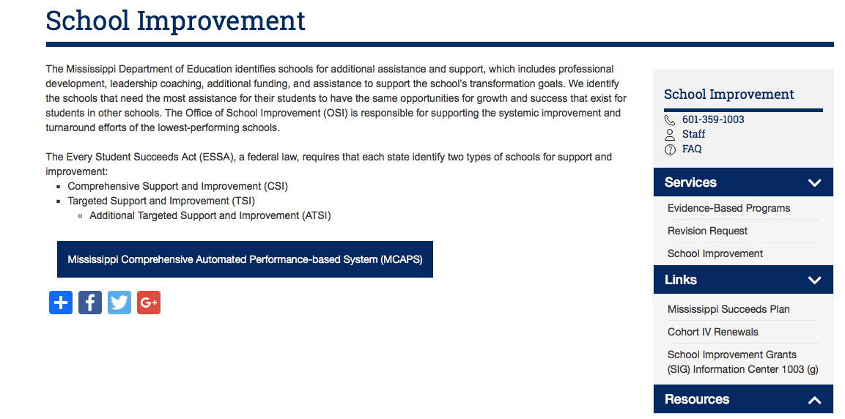
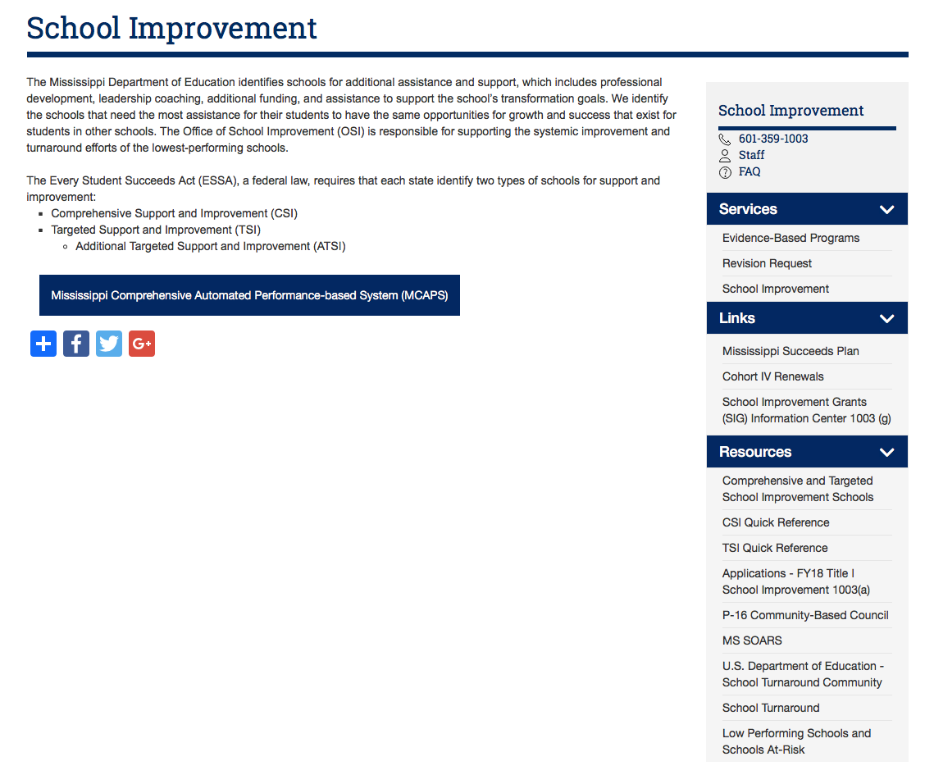
Accessing the Toolkit

Slide 20
Stage 2: Selection of the P16 Council Members
Divide participants into groups based on the membership categories. This may include:
PTO
local community-based organizations
Public officials
Make a selection to determine the number of members as previously determined by initiators
Once all members have been selected, the role of the initiators ends and the new members take responsibility for the conduct of the P-16 Council
Notes:
During the stage 2 meeting- participants should be divided up based on the six constituent categories. A selection is then made to determine the number of members as previously determined by initiators.
Bullet two- The question may come- Can initiators participate as group members? Yes based on the 6 categories and are eligible to be selected as individuals on the same basis as any other person.
The responsibility of the initiators only to establish the groundwork of the council. They do not have to be members once the council is formed.

Slide 21
P16 Community Engagement - Toolkit
In the toolkit that has been prepared, please find the following tools that you can immediately put to use:
Selecting P-16 Council Members page 11
Sample Agenda page 11
Notes:
Again, I have provided page numbers of the toolkit that align with stage 2 of this process.

Slide 22
Stage 3: Formation of the P16 Council
The Council becomes independent of the local school district or school
Notes:
What does independent look like and mean for the P-16 Council- The council no longer operates under the district but under internal leadership of the council.

Slide 23
What is the role of the P16 and School/District?
P16 (What it is - Roles and Responsibilities) | P16 (What it is Not) | School/District (Roles/Responsibilities)
Provide ideas, partnerships, and information that can help the schools succeed. | Not another school board and does not have any mandating or enforcement authority | Work with the P16 to provide data and information related to key P16 policy areas (district policies, achievement data, student discipline, etc.)
Suggest policy and actions to the school district or school administration | Not supposed to conduct direct programs or projects | Work in partnership with the P16 to develop solutions to the most pressing needs of the district
Examine policy and to advocate for the enforcement of policies that are good for children | Not a place for politics
Notes:
Roles and responsibilities of the P16 council are noted.
Read slides

Slide 24
P16 Community Engagement - Toolkit
Rules and Regulations governing P16 Councils Page 3
What does independence mean? Page 14
What is the role of the P-16 Council? Page 15
Notes:
To get a more thorough definition of what independence means for the council, you may refer to page 14 in the toolkit as well as what policy says regarding the council and their role in supporting schools and districts.

Slide 25
Building Partnerships
Is what I’m doing, or about to do, going to improve student achievement? | How does this decision improve the quality of instruction and outcomes for ALL students?
Notes:
At the end of the day, if schools and districts want to maintain the fidelity of their P16 council, they should ask themselves two questions?
Is what I’m doing, or about to do, going to improve student achievement? And How does this decision improve the quality of instruction and outcomes for ALL students? If these questions are kept at the forefront of conversations and decision making, it keeps the focus on making sure that what you do is being done in the best interest of children.

Slide 26
Reflection Points – Next Steps
Determine whether or not your school and/or district is required to implement a P16 Council
Decide what type of P16 Council will be implemented (District or School)
Download P16 Guidance Toolkit (OSI Website)
Meet with your SLT to review the guidance document and develop action steps to move forward
Notes:
So, as you move forward in this process, certain steps should be followed to carry out this requirement
Read the slide

Slide 27
School Improvement Contact Information
Dr. Sonja J. Robertson Executive Director srobertson@mdek12.org
Ms. Shakinna Patterson, Ed.S. Director of School Improvement Programs spatterson@mdek12.org | Mrs. Jeanne Park Lead Implementation Specialist/UM jeanne.park@mdek12.org | Office of School Improvement 359 North West St. P. O. Box 771 Jackson, MS 39205-07 http://www.mdek12.org/OSI
Dr. BoNita Harris Director of Program Monitoring and Support bharris@mdek12.org | Dr. Lekeisha Sutton Lead School Improvement Coach/UM lsutton@mdek12.org
Dr. Sharita Giles Coordinator of School Improvement Programs – MCAPS sgiles@mdek12.org | Mr. Michael McDonald Lead School Improvement Coach/UM mimcdonald@mdek12.org
Mrs. Noleen Clark Coordinator of School Improvement Programs nclark@mdek12.org | Mrs. A’Lisa Bryant Fiscal Office Manager abryant@mdeki.org
Mrs. Re’Nona Jackson Program Office Manager rjackson@mdeki.org

Slide 28
Questions
114

