Slide 1
New Special Education Teacher Webinar Series
Reevaluation Guidelines
January 2018
Madelyn Harris, M.S.
Instructional Support Specialist
mharris@mdek12.org

Slide 3
State Board of Education Goals FIVE-YEAR STRATEGIC PLAN FOR 2016-2020
All Students Proficient and Showing Growth in All Assessed Areas
Every Student Graduates from High School and is Ready for College and Career
Every Child Has Access to a High-Quality Early Childhood Program
Every School Has Effective Teachers and Leaders
Every Community Effectively Uses a World-Class Data System to Improve Student Outcomes
Every School and District is Rated “C” or Higher

Slide 4
Teacher Listserv

Slide 5
Overview

Slide 6
Target Audience
This webinar series is intended for special education teachers with 0-3 years experience. However, it is available to anyone who would like to participate.

Slide 7
Purpose
To provide support and guidance to new special education teachers on a consistent basis throughout the school year
To address the topics and issues that are relevant to new special education teachers in a timely manner

Slide 8
Registration and Dates
Registration link:
https://attendee.gotowebinar.com/register/8555677492844037122
The webinar will be the first Thursday of every month at 3:00 p.m.
October 5, 2017 February 1, 2018
November 2, 2017 March 1, 2018
December 7, 2017 April 5, 2018
January 11, 2018

Slide 9
Recordings
For those who are not able to participate in the live webinar, the recordings will be posted to the Office of Special Education’s website along with any supporting documents that may be referenced during the webinars.
The webinar recordings can be found by clicking on the following link: www.mdek12.org/ose/training/webinars.

Slide 10
Format
Hot Topics will address any new initiatives or important updates in special education.
Do Now will provide teachers with a “To-Do List” of time- sensitive tasks.
Did You Know will address specific special education topics.
FAQ will answer questions submitted by participants.

Slide 11
Questions
Submit questions to be addressed during the FAQ section of each webinar to scoon@mdek12.org by the Friday prior to the first Thursday of each month.
Put New Special Education Teacher FAQ in the subject line.

Slide 12
Hot Topics

Slide 13
Test Participation Rates
Participation Rates
56/58 Rule –Applies to all students, not just SCD
Non-Tested Students
1% Cap on SCD Rate
Justification if over 1%
.

Slide 14
Do Now

Slide 15
Do Now
Check reevaluation dates to ensure compliance with three-year timeline.
Prepare for progress monitoring before and after Christmas break to collect data for ESY determination.

Slide 16
Did You Know?

Slide 17
Reevaluations
Public agencies will ensure that all children with disabilities are evaluated periodically to determine whether the child continues to have a disability that requires special education and related services.
State Board Policy Chapter 74, Rule 74.19
§ 300.303

Slide 18
Reevaluations
Unless the parent and the public agency agree to an exception, reevaluations
Must occur at least once every three years
May occur not more than once a year
Must be documented on the Eligibility Determination Report

Slide 19
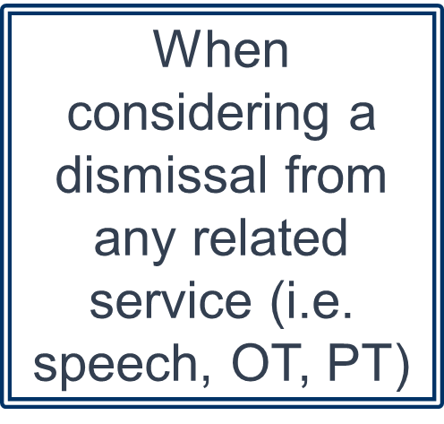
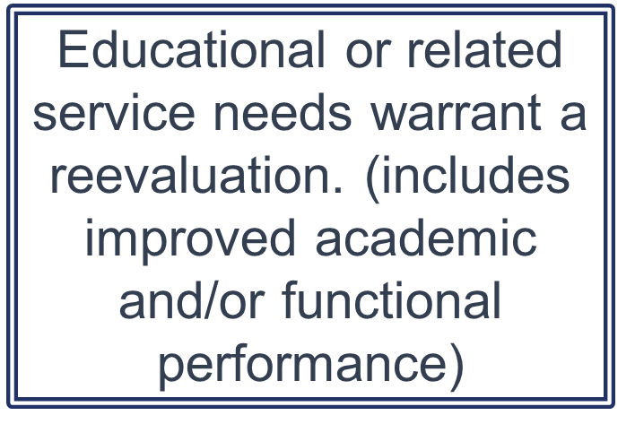
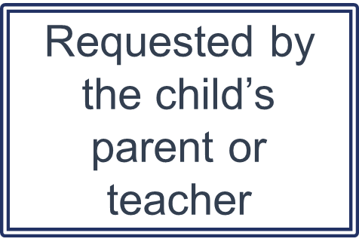
Reevaluations
When should a reevaluation be considered more often than every 3 years?

Slide 20
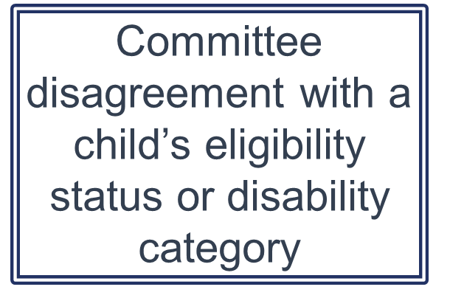
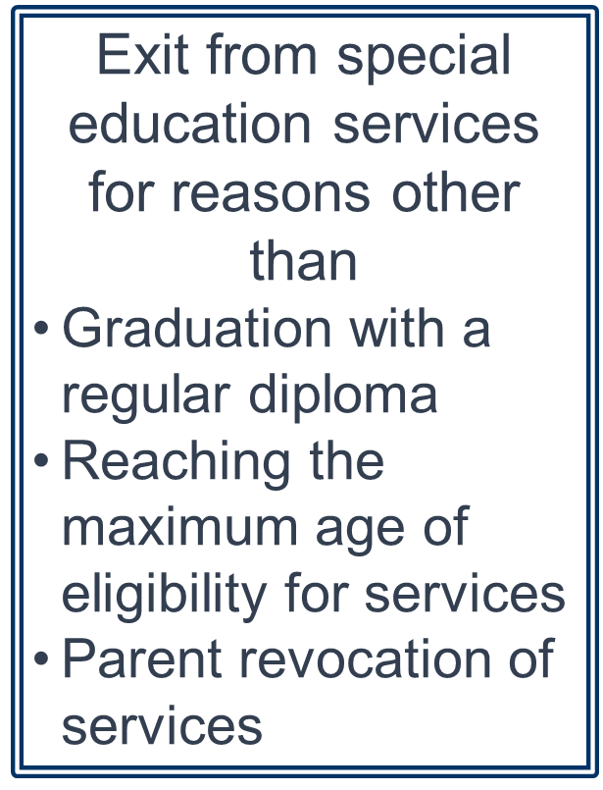
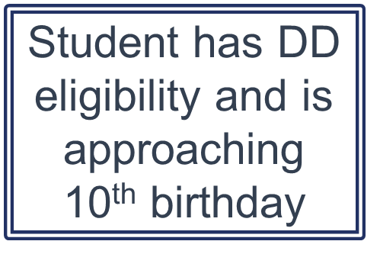
Reevaluations
When should a reevaluation be considered more often than every 3 years?

Slide 21
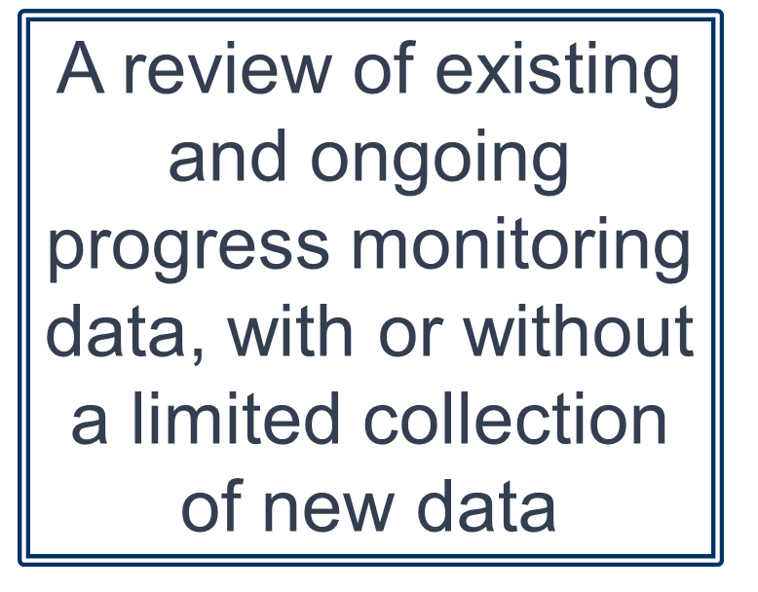
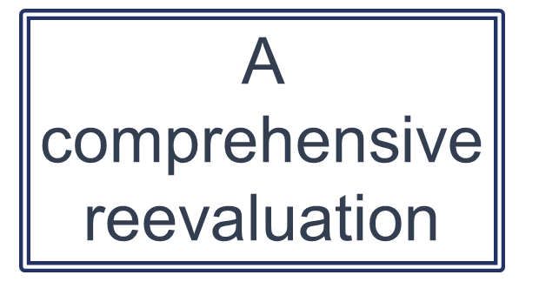
Reevaluations
A reevaluation may consist of
Notes:
Review of existing information
Can be conducted with or without a formal meeting, but ALL committee members must have input and a chance to review data
Can include evaluations and information provided by the parent, current curriculum-based assessments, progress monitoring data, and other ongoing observations, information from existing observations by teachers and related services providers, information contained in the current IEP, including progress reports on goals
To determine if additional data are needed to establish continued eligibility and determine appropriate service provision
If no info needed, document in writing
If the IEP Committee or any member determines that additional data are needed, they must identify the data needed to determine
Whether the child continues to have a disability
Whether the child continues to need special education and related services
The child’s present levels of academic achievement and functional performance & educational needs
Any additions or modifications necessary for the child to meet their annual IEP goals and/or to participate in the general curriculum or developmentally-appropriate activities

Slide 22
Parental Consent for Reevaluation
Consent is recommended but not required prior to conducting a reevaluation using existing data
When additional data are needed, the IEP Committee must
Provide the parent with Prior Written Notice of the public agency’s intention to conduct a reevaluation
Obtain Informed Parental Consent prior to conducting any new individual assessments

Slide 23
Parental Consent for Reevaluation
If a parent fails to respond to the request for consent, the public agency may proceed with the new individual assessments if it has made reasonable attempts to obtain consent from the parent.
If the parent refuses to consent for additional data collection for reevaluation, the public agency may not conduct new individual assessments for the reevaluation.
A comprehensive reevaluation should be completed within a reasonable time.
Notes:
Public agency may continue to collect ongoing progress monitoring data which may be used to determine if the child continues to be eligible for special education and the child’s educational needs.
If a parent refuses to provide consent, the public agency may, but is not required, to use due process procedures to override the parent’s refusal.

Slide 24
Reevaluation Report
The IEP Committee must document the results of the reevaluation in a written reevaluation report(s).
Must meet the same criteria as evaluation reports
May compile all reevaluation information into a single comprehensive report or allow each examiner to submit an individual report
Parents receive a copy of all reevaluation reports at least seven (7) calendar days prior to the meeting to determine or reestablish eligibility

Slide 25
Eligibility Determination Meeting
The IEP Committee, which includes the parent, must meet to review the reevaluation report(s) and to draft an eligibility determination report
Parent must be invited in writing to attend the eligibility determination meeting
Must document eligibility decision in an Eligibility Determination Report to either continue or change the eligibility

Slide 26
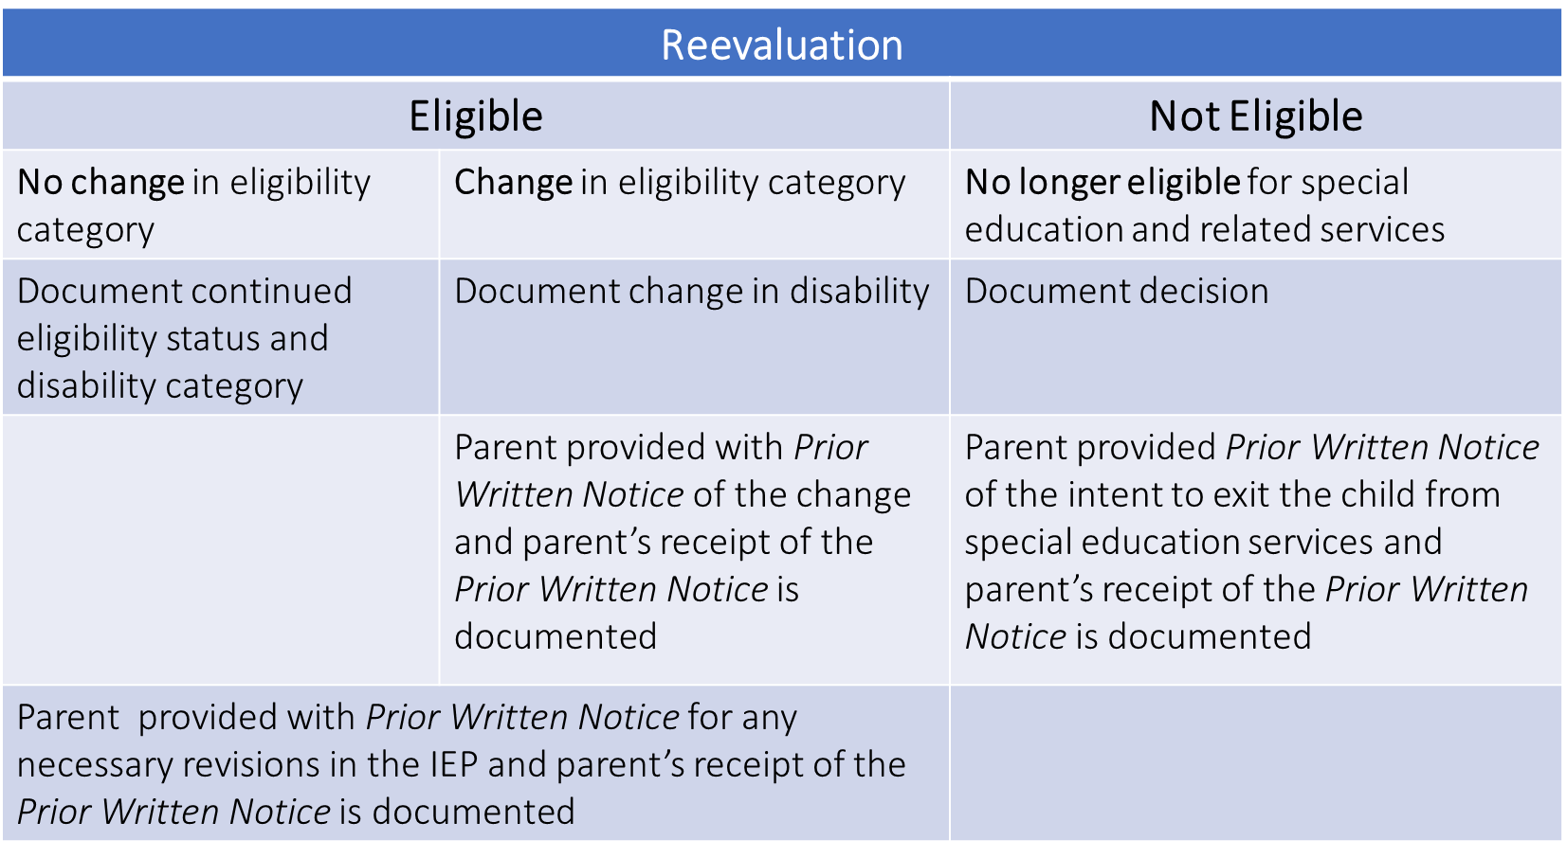
Reevaluation Decisions
Notes:
If the parent is in attendance at the IEP Committee meeting, the public agency may provide any required Prior Written Notice to the parent at the meeting.
Also, can use same PWN for change in eligibility category and IEP revision
PWN decisions for reeval:
IEP Committee proposes to
Gather additional data, or
Determine continuing eligibility and child’s educational needs based on existing data, or
IEP Committee refuses to
Gather additional data, assessment, or
Continue eligibility based on existing data

Slide 27
Madelyn Harris, M.S.
Instructional Support Specialist
mharris@mdek12.org
601-359-3498

