Slide 1
Free Appropriate Public Education in the Least Restrictive Environment
Special Education Directors Quarterly Meeting
April 11, 2016

Slide 2
State Board of Education
Vision
To create a world-class educational system that gives students the knowledge and skills to be successful in college and the workforce, and to flourish as parents and citizens
Mission
To provide leadership through the development of policy and accountability systems so that all students are prepared to compete in the global community

Slide 3
State Board of Education Goals
5-Year Strategic Plan for 2016-2020
All students are proficient and show growth in all assessed areas
Every student graduates high school and is ready for college and career
Every child has access to a high quality early childhood program
Every school has effective teachers and leaders
Every community effectively uses a world-class data system to improve student outcomes

Slide 4
Brown vs. Board of Education, 347 U.S. 483, 495 (1954)
Decision helped end segregation by holding that “[s]eparate educational facilities are inherently unequal.”

Slide 5
In the span of the next few years (1971 through 1973), the federal courts made it clear that schools owed students the equal protection of the law without discrimination on the basis of disability, just as the Supreme Court had ruled in Brown v. Board of Education in regard to race.
The due process clause of the Fourteenth Amendment was interpreted to give parents specific rights to prior notice, to discuss changes in a child's education plan before they occurred, and to appeal decisions made by school districts.
SOURCE: From The Future of Children, a publication of the David and Lucile Packard Foundation from 1991 to 2004, vol 6, no. 1, Spring 1996

Slide 6
Pennsylvania Ass'n for Retarded Children v. Com. of Pa., 343 F. Supp. 279, 303 (E.D. Pa. 1972)
The Court’s decree laid the foundation for the establishment of the right to an education for all children with disabilities.
This case also established the standard that each child must be offered an individualized education and that children should be placed in the least restrictive environment to the maximum extent possible.
SOURCE: http://www.pilcop.org/pennsylvania-association-for-retarded-citizens-parc-v-commonwealth-of-pennsylvania/#sthash.EMeDjYbJ.dpbs

Slide 7
Mills v. Bd. of Ed. of D.C., 348 F. Supp. 866 (D.D.C. 1972)
Mills established the fundamental Constitutional right to education of all children with disabilities.
Quoting liberally from Brown, the court in Mills likened the treatment of the plaintiff students to the segregation outlawed by the Supreme Court in Brown.
SOURCE: From The Future of Children, a publication of the David and Lucile Packard Foundation from 1991 to 2004, vol 6, no. 1, Spring 1996

Slide 8
Mills v. Bd. of Ed. of D.C., 348 F. Supp. 866 (D.D.C. 1972) cont.
School districts were constitutionally prohibited from deciding that they had inadequate resources to serve children with disabilities because the equal protection clause of the Fourteenth Amendment would not allow the burden of insufficient funding to fall more heavily on children with disabilities than on other children.
SOURCE: From The Future of Children, a publication of the David and Lucile Packard Foundation from 1991 to 2004, vol 6, no. 1, Spring 1996

Slide 9
Mills v. Bd. of Ed. of D.C., 348 F. Supp. 866 (D.D.C. 1972) cont.
Specifically, Mills ruled that children with disabilities had:
an equal right to public education offered in a form that was meaningful for them,
when the school considered a change in their status
including suspension, expulsion, reassignment,
or transfers out of regular public school classes), the
children were entitled to full procedural protections,
including
notice of proposed changes, access to school records, a right to be heard and to be represented by legal counsel at hearings to determine changes in individual programs, and regularly scheduled status reviews.
SOURCE: From The Future of Children, a publication of the David and Lucile Packard Foundation from 1991 to 2004, vol 6, no. 1, Spring 1996

Slide 10
The ruling in Mills was pivotal and far-reaching. Many provisions eventually were encompassed in P.L. 94-142.

Slide 11
Individuals with Disability Education Act (IDEA)
The Individuals with Disabilities Education Act (IDEA) is a federal law ensuring services to children with disabilities throughout the nation. IDEA governs how states and public agencies provide early intervention, special education and related services to more than 6.5 million eligible infants, toddlers, children and youth with disabilities.
Was enacted “[t]o assure that all children with disabilities have available to them . . . a Free Appropriate Public Education which emphasizes special education and related services designed to meet their unique needs.”

Slide 12
Individuals with Disability Education Act (IDEA) cont.
In response to the finding that disabled children were being “excluded entirely from the public school system and from being educated with their peers[,]“ Congress enacted IDEA.
20 U.S.C. § 1400(c)(2)(B)
“The statute was designed primarily to bring disabled students into the public educational system and ensure them a free appropriate public education.”
R.H. v. Plano Indep. Sch. Dist., 607 F.3d 1003, 1014-15 (5th Cir. 2010) (emphasis omitted).

Slide 13
Free Appropriate Public Education (FAPE)
FAPE is defined in the 2006 IDEA regulations at 34 C.F.R. § 300.17 as special education and related services that:
Are provided at public expense, under public supervision and direction, and without charge;
Meet the standards of the State educational agency;
Include an appropriate preschool, elementary school, or secondary school education in the State involved; and
Are provided in conformity with an IEP that meets the requirements of 34 C.F.R. §§ 300.320–300.324.

Slide 14
Educational Benefit
Educational Benefit Reflects on the quality of IEP development to increase student access, participation, and progress in the general education curriculum
The intent of a “Free Appropriate Public Education” (FAPE) for students with disabilities is to design individualized instruction with sufficient supports and services to enable the student to receive educational benefit.

Slide 15
Educational Benefit
The Purpose of the Educational Benefit Review Process is:
to determine whether the design of the IEP was “reasonably calculated”* for the student to receive educational benefit.
*Reasonable Calculation evaluates whether the IEP reflects on the student’s present levels of performance, goals, supports and maximum access, participation and progress in the general education curriculum.

Slide 16
Educational Benefit Test Under IDEA – FOUR FACTORS:
the program is individualized on the basis of the student's assessment and performance;
the program is administered in the least restrictive environment;
the services are provided in a coordinated and collaborative manner by the key ‘stakeholders'; AND
positive academic and non-academic benefits are demonstrated.
S.H. ex rel. A.H. v. Plano Indep. Sch. Dist.,
487 F. App'x 850, 859 (5th Cir. 2012)
(citing Cypress-Fairbanks Indep. Sch. Dist. v. Michael F. by Barry F., 118 F.3d 245, 253 (5th Cir. 1997))

Slide 17
Least Restrictive Environment
LRE is a legal mandate of the IDEA requiring that students with disabilities receive their education in the regular classroom environment to the maximum extent appropriate, or the extent such placement is not appropriate, in an environment with the least possible amount of segregation from the students’ nondisabled peers and community.
34 CFR § 300.114(a)(2)

Slide 18
Least Restrictive Environment
Each public agency must ensure that-
(i) To the maximum extent appropriate, children with disabilities, including children in public or private institutions or other care facilities, are educated with children who are nondisabled; and

Slide 19
Least Restrictive Environment
ii) Special classes, separate schooling, or other removal of children with disabilities from the general educational environment occurs only if the nature or severity of the disability is such that education in general education classes with the use of supplementary aids and services cannot be achieved satisfactorily.

Slide 20
Least Restrictive Environment
Each public agency must ensure that a continuum of alternative placements is available to meet the needs of children with disabilities for special education and related services.

Slide 21
R.H. v. Plano Indep. Sch. Dist., 607 F.3d 1003, 1013 (5th Cir. 2010)
In R.H., the parent argued that “the district did not consider placing [the student] anywhere except . . . [in] a “special education” setting, not a “regular” setting. It follows that [the District] took no “steps to accommodate [him] in regular education,” as required by the IDEA.

Slide 22
R.H. v. Plano Indep. Sch. Dist., 607 F.3d 1003, 1013 (5th Cir. 2010)
Though the Fifth Circuit did not agree with the parent in R.H., the reason(s) why the District won are instructive.
The Fifth Circuit noted that “the hearing officer found that [the District] had considered placing R.H. in a fully mainstreamed environment but rejected that option. That finding was amply supported by evidence offered at the due-process hearing.”

Slide 23
R.H. v. Plano Indep. Sch. Dist., 607 F.3d 1003, 1014 (5th Cir. 2010)
The evidence the District presented at the Hearing included that “the committee was aware of R.H.'s previous enrollment at [another school], but [decided the placement option] because of the needs identified in R.H.'s IEP—
a low staff-to-student ratio,
a special education teacher with knowledge of autism,
regular collaboration with a speech pathologist”

Slide 24
Least Restrictive Environment
The continuum of alternative placements available to meet the needs of children with disabilities for special education and related services must-

Slide 25
Least Restrictive Environment
Includes the alternative placements listed in the definition of special education (instruction in regular classes, special classes, special schools, home instruction, and instruction in hospitals and institutions); and
Makes provision for supplementary services (such as resource room or itinerant instruction) to be provided in conjunction with general education class placement.

Slide 26
Least Restrictive Environment
A child with a disability is not removed from education in age-appropriate general education classrooms solely because of needed modifications in the general education curriculum.

Slide 27
Least Restrictive Environment
If the IEP Committee determines that “full time” education in the general education classroom cannot be achieved satisfactorily, the student with disabilities must be included in the general education classroom to the maximum extent appropriate.

Slide 28
Fifth Circuit’s Interpretation of Maximum Extent Possible and LRE:
Child "was enrolled in mainstream classes to the greatest extent possible, and our jurisprudence suggests that the attendance of regular classes is the least restrictive environment.” Lewisville Indep. Sch. Dist. v. Charles W. ex rel. Charles W., 81 F. App'x 843, 847 (5th Cir. 2003)
The least restrictive environment has been defined in this Circuit as “not only freedom from restraint, but the freedom of the child to associate with his or her family and able-bodied peers to the maximum extent possible.” Teague Indep. Sch. Dist. v. Todd L., 999 F.2d 127, 128 n. 2 (5th Cir. 1993) (citing Sherri A.D. v. Kirby, 975 F.2d 193, 207 n. 23 (5th Cir.1992))

Slide 29
Fifth Circuit’s Interpretation of Maximum Extent Possible and LRE:
The Fifth Circuit has held that even attending some classes with general education peers without disabilities offers a less restrictive environment:
An “IEP proposed by [a school district], which would have allowed [a student] to live at home and attend some regular classes [was] obviously less restrictive than the residential placement proposed by the parents.”
Salley v. St. Tammany Parish Sch. Bd.,
57 F.3d 458, 467 (5th Cir.1995)

Slide 30
United States Department of Education Guidance –
“Placement” versus “Location”
The Comments to 34 CFR § 300.114-120, at page 46588 (Placement Issues and LRE) discuss the difference between placement and location. “Placement” refers to the points along the continuum of placement options and “location” is the physical surrounding such as the particular classroom. The school should have the flexibility to assign the child to a particular school or classroom provided that it is consistent with the placement determination. Schools are strongly encouraged to place the student in the school and classroom the child would attend if not disabled.
Art Cernosia, Presentation, Mississippi Hearing Officer and Mediator Training: An Overview of the Law, June 2015, pp. 27-28

Slide 31
How Do We Determine Placement?
The placement decision-
(1) Is made by a group of persons, including the parents, and other persons knowledgeable about the child, the meaning of evaluation data, and the placement options; and
(2) Is made in conformity with the LRE provisions.

Slide 32
Placements
The child’s placement-
Is determined at least annually;
Is based on the child’s IEP; and
Is as close as possible to the child’s home;
Unless the IEP of a child with a disability requires some other arrangement, the child is educated in the school he or she would attend if nondisabled.
Consideration is given to any potential harmful effect on the child.
34 C.F.R. § 300.116(b)-(d)

Slide 33
White ex rel. White v. Ascension Par. Sch. Bd., 343 F.3d 373, 380 (5th Cir. 2003):
School District elected to provide services at a centralized location. Court held "This is a permissible policy choice under the IDEA. Schools have significant authority to determine the school site for providing IDEA services."

Slide 34
White ex rel. White v. Ascension Par. Sch. Bd., 343 F.3d 373, 380 (5th Cir. 2003):
But note that the District "proffered numerous, sound reasons for its centralization policy, including:
ability to cover absences and scheduling difficulties;
training and staff development;
effective use of limited resources; and
educational and social advantages.

Slide 35
White ex rel. White v. Ascension Par. Sch. Bd., 343 F.3d 373, 380 (5th Cir. 2003):
Additionally, in this specific case,
while [the student] is the only student now served by the transliterator, another student needing to share the transliterator could move into the district; and
making an exception to the centralization policy for [the student] would not be fair to other students who share transliterators and must attend the centralized school."

Slide 36
United States Department of Education Guidance
The Comments to 34 CFR § 300.114-120, at page 46588 (Placement Issues and LRE) clarify that placement decisions cannot be made solely on factors such as category of disability, severity of the disability, availability of special education and related services, configuration of the service delivery system, availability of space, or administrative convenience.
Art Cernosia, Presentation, Mississippi Hearing Officer and Mediator Training: An Overview of the Law, June 2015, pp. 27-28

Slide 37
Daniel R.R. v. State Bd. of Educ., 874 F.2d 1036, 1048 (5th Cir. 1989)
“First, we ask whether education in the regular classroom, with the use of supplemental aids and services can be achieved satisfactorily for a given child."
“If it cannot and the school intends to provide special education or to remove the child from regular education, we ask, second, whether the school has mainstreamed the child to the maximum extent appropriate.”

Slide 38
Maximum Extent Possible?
LRE also applies to non-academic and extracurricular services and activities such as recess, meals, athletics, counseling, groups and clubs.

Slide 39
Non-Academic Benefit
“[A]cademic achievement is not the only purpose of mainstreaming.” Daniel R.R. v. State Bd. of Educ., 874 F.2d 1036, 1048 (5th Cir. 1989)
A student may derive nonacademic benefit from interacting with [nondisabled] peers in mainstream classes. J.H. ex rel. A.H. v. Fort Bend Indep. Sch. Dist., 482 F. App'x 915, 919 (5th Cir. 2012)

Slide 40
Applying the second prong of the Daniel R.R. TEST / determining the “maximum extent possible”:
Ask: Has the student with disabilities derived any significant academic OR nonacademic benefit from placement in mainstream classes?
Ask: Can you prove** it?
**Note that in the LRE cases where the District prevailed, the Court cited to specific testimony or instances where teachers and administrators were able to describe the behavior of the student in the general education setting, as well as the accommodations and modifications needed in those settings, and whether there was any (non)academic benefit.

Slide 41
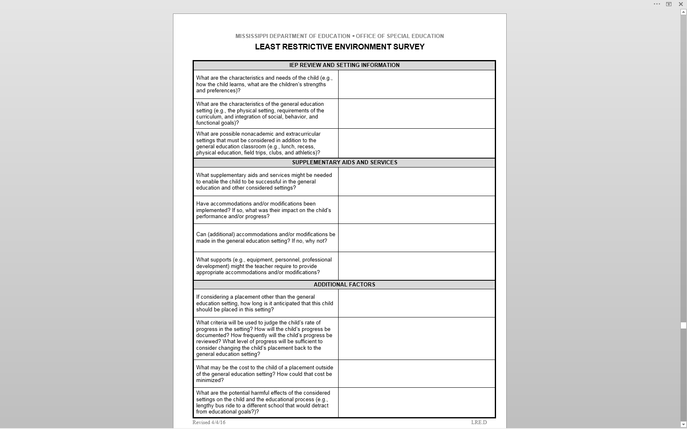
Least Restrictive Environment Survey

Slide 42
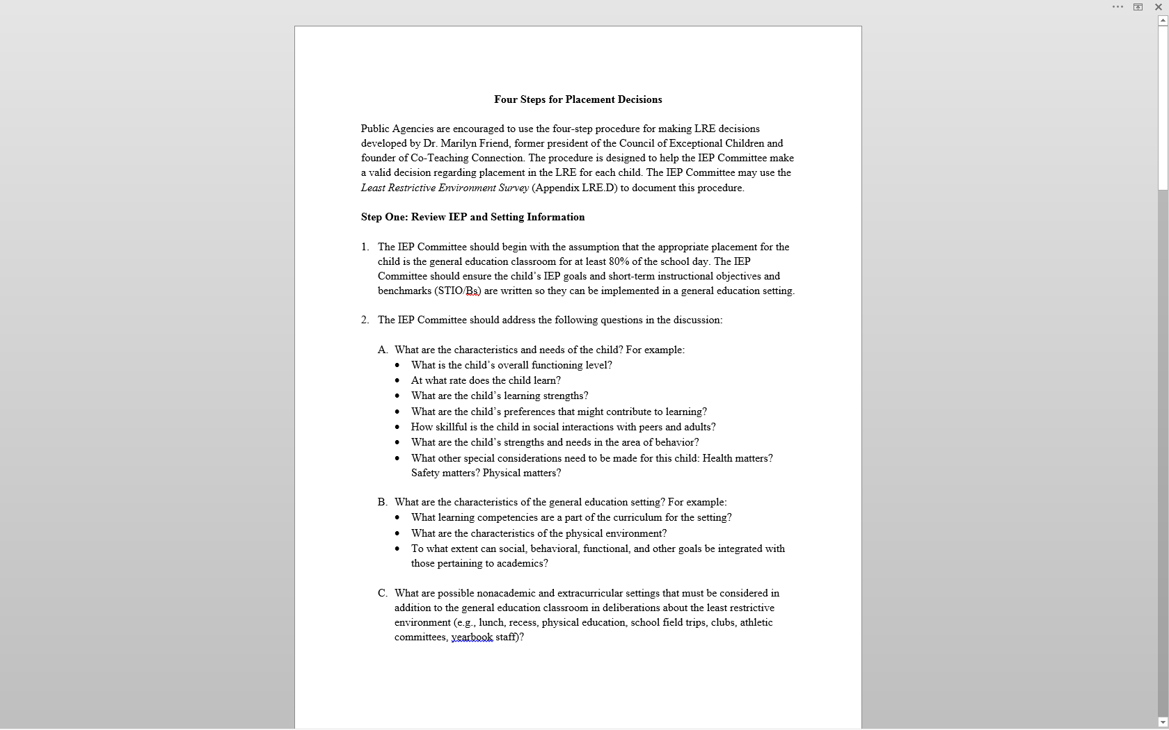
Four Steps for Placement Decisions

Slide 43
Results of Monitoring
Areas of Noncompliance:
IEP- no progression of goals, LRE, accommodations/modifications
FAPE- IEP, services not provided in the LRE, placement decisions made outside of the IEP Committee (administrative)
Educational Benefit- no progression of goals, no progression of LRE

Slide 44
Department of Justice (DOJ) Findings
State of MS has failed to meet its obligations under Title II of the ADA by unnecessarily institutionalizing persons with mental illness or DD in public and private facilities and failing to ensure that they are offered a meaningful opportunity to live in integrated community settings consistent with their needs.

Slide 45
Department of Justice (DOJ) Findings
The State of Mississippi fails to provide services to qualified individuals with disabilities, including mental illness and developmental disabilities, in the most integrated settings appropriate to their needs, in violation of the ADA.
Qualified individuals are segregated from non-disabled persons and lead lives of limited choice or independence. They are deprived of meaningful opportunities to choose friends, participate in employment, or make choices about activities, food or living arrangements.

Slide 46
Department of Justice (DOJ) Findings
Undue segregation causes harm to the individuals who are unnecessarily institutionalized.
The State is violating the ADA by failing to serve qualified individuals with disabilities in the most integrated setting.
The State fails to provide children with disabilities with medically necessary and educational services in violation of federal law, which further exposes children to unnecessary institutionalization.

Slide 47
Contact Information
M. April Rice
marice@mde.k12.ms.us
Tanya Bradley
tbradley@mde.k12.ms.us
Office of Professional Development and District Support
(601) 359-3498

