Slide 2
FYI Note from MDE
This event is being funded with State and/or Federal funds and is being provided for employees of school districts, employees of the Mississippi Department of Education and Department contractors. Miss. Const. Art. 4, Section 66 prohibits governing authorities from making donations. According to the Mississippi Attorney General, once the Federal funds are turned over to the State, the rules for the expenditure of State funds apply. Based on Mississippi law, this event is not being provided for third party vendors or external providers.

Slide 3
State Board of Education
Vision _________________________________
To create a world-class educational system that gives students the knowledge and skills to be successful in college and the workforce, and to flourish as parents and citizens
Mission _______________________________
To provide leadership through the development of policy and accountability systems so that all students are prepared to compete in the global community

Slide 4
State Board of Education Goals 5-Year Strategic Plan for 2016-2020
All Students Proficient and Showing Growth in All Assessed Areas
Every Student Graduates High School and is Ready for College and Career
Every Child Has Access to a High-Quality Early Childhood Program
Every School Has Effective Teachers and Leaders
Every Community Effectively Using a World-Class Data System to Improve Student Outcomes
Every School and District is Rated “C” or Higher

Slide 5
Teacher Listserv
The OSE has a teacher listserv available for special education teachers.
The purpose of the listserv is to inform special education teachers of upcoming trainings, upcoming webinars, and other resources provided by MDE.

Slide 6
Teacher Listserv

Slide 7
Strong Readers=Strong Leaders Campaign
Strong Readers=Strong Leaders Statewide public awareness campaign promotes literacy, particularly among PreK-3 students.
Campaign aims to equip parents and community members with information and resources to help children become strong readers.
Notes:
The Strong Readers=Strong Leaders campaign supports the Literacy-Based Promotion Act by educating parents about the important of literacy and giving them resources to help children at home. Almost two-thirds of a child’s waking hours are spent with parents or other caregivers. Family involvement is key to helping children become successful readers.
The campaign officially launched in late May with a press conference at the Eudora Welty Library featuring our campaign spokesperson, Miss Mississippi Jasmine Murray. We partnered with the Mississippi Library Commission on this event and timed it to kick off the summer reading season. We got good local coverage of the event, which included Jasmine Murray reading to preschoolers.

Slide 8
Strong Readers=Strong Leaders Campaign
How districts can get involved:
Post logo and link to strongreadersMS.com
on district website.
Share PSA on website and social media.
Like Strong Readers on Facebook and follow @StrongReadersMS on Twitter.
Help implement mentoring program.
Distribute bookmarks and posters.
Notes:
We need your help to promote this campaign. You can download the logo, PSA, posters and bookmarks from the “Educators” section on the Strong Readers website. We would love for you to post the logo on your websites and link it to StrongReadersMS.com. Also, please follow Strong Readers on social media and encourage the parents in your districts to do the same. Follow up with your superintendents after the MASS conference to see about the feasibility of starting a mentoring program.
Also, please share any literacy information you have with us so we can post it on StrongReadersMS.com. You can email your stories and photos to Jean Cook - jcook@mde.k12.ms.us.

Slide 9
MDE Professional Development Calendar

Slide 10
MDE Professional Development Calendar

Slide 11
Different Views

Slide 12
Highlights a Snapshot of Training

Slide 13
Click on Training for Info

Slide 14
Link to Register

Slide 15
Alignment of Training to Strategic Plan
This training is designed to provide an overview of accommodations and modifications. According to State Board Policy Chapter 74, Rule 74.19, students with disabilities should be given accommodations and/or modifications to help ensure academic success.

Slide 16
Accommodations and Modifications
Federal and State laws and regulations require schools to provide accommodations and modifications to make sure that students with a disability have access to an appropriate educational program.
The Individuals with Disabilities Education Act (IDEA 2004)- requires that students with a disability have the opportunity to be involved and make progress in the general curriculum.
Section 504 of the Rehabilitation Act of 1973 - requires that accommodations be provided to students with a disability, even if they do not have an IEP.
The Americans with Disabilities Act of 1990 - prohibits discrimination against any people with disabilities.

Slide 17
Who is Eligible for Accommodations and Modifications?
Students who have been evaluated and determined to have a disability under IDEA and who are receiving specially-designed instruction are eligible for accommodations and modifications. Professionals, family members and the students (if applicable) work together on the IEP team to develop an Individualized Education Program (IEP). The IEP Committee looks at the student’s present levels of performance and educational needs and decides what kinds of accommodations and modifications are needed.

Slide 18
How are IEP Decisions Made?
The IEP Committee discusses what accommodations are necessary for the child to be successful in school. The following questions may be asked:
Does the child have the basic knowledge and skills that are needed for this grade level or course?
How independent is the child in completing assignments?
Does the child learn and work as fast as other students in the class?
Can the child be expected to complete the tests and assignments that are generally used in class?
Can the child use the same books and instructional resources as the other students?
What kinds of strategies are needed to help the child behave in class?
What accommodations will be needed in the school or classroom environment?
Will teachers need additional support to work with the child?

Slide 19
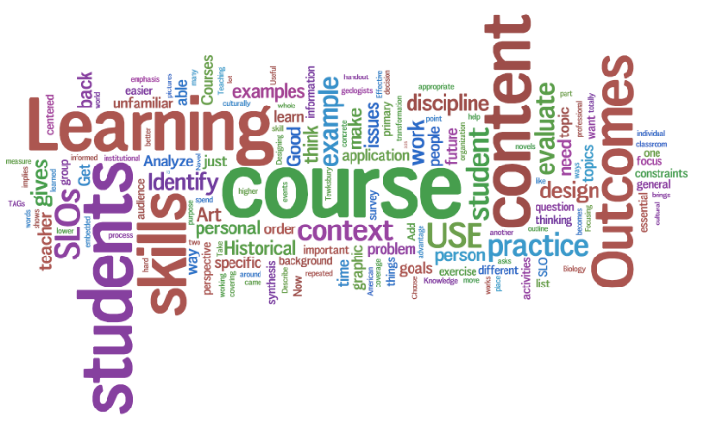
Accommodations
Accommodations are really “whatever it takes” to make sure that students with disabilities can participate as fully as possible in the general curriculum and ultimately earn a high school diploma.
Accommodations can be provided for:
instructional methods and materials
learning environments
time demands and scheduling
special communication systems
****Levels the “playing field”****

Slide 20
Accommodations
Accommodations
DO NOT fundamentally alter or lower
expectations or standards in instructional
level, content or performance criteria.
Changes are made in order to provide
equal access to learning and equal
opportunity to demonstrate what is
known.
Should provide access not advantage to
students.
Notes:
Station teaching

Slide 21
Examples of Accommodations
Accommodations are basically physical or environmental changes, generally referred to as good teaching strategies.
Extended time, frequent breaks, varying of activities
Change in classroom, preferential seating, physical arrangement of the room, reducing/minimizing distractions, cooling off period
Emphasizes varied teaching approaches (visual, auditory, multi-sensory), individual or small group, demonstrating/modeling, visual cues, use of manipulatives, pre-teaching, graphic organizers
Highlighting material, note taking assistance, notes provided by teacher, calculator, computer, Braille and/or large print

Slide 22
Examples of Accommodations (Continued)
Directions given in small sections, sequential steps, copying from book
Positive reinforcement, concrete reinforcement, checking for understanding, study guides, before/after school tutoring
Reading test (when allowed), shortening length of test, test format changed (multiple choice vs. fill in the blank)
Allow for verbal response

Slide 23
Accommodation Data Collection Tool
This chart can be used to track different aspects of how a student uses an accommodation in your classroom and to help decision making on assessment accommodations.
Student___________________ Date ____________
List Accommodations the student uses in the classroom. Then apply the questions in the chart and record your observations.
 | List Accommodations
Questions | Example: cue to stay on task
1. Is it noted on the student’s IEP or 504?
2. For what task (s) is it used? (e.g., task type or content/standard)
3. Does the student use it for that task every time? Note how often.
4. Does the student use it alone or with assistance? (e.g., Aide, peers)
5. Notes: (e.g., does one accommodation seem more effective than another on a task, etc. )
Revised from Colorado Department of Education

Slide 24
Modifications
The IEP Committee decides if curriculum modifications are needed for a student with a disability.
Modifications may include:
completion of part of the program or some of the course requirements
curriculum expectations below age or grade level
alternate curriculum goals
alternate assessments
****Creates the “playing field”****

Slide 25
Modifications
Modifications
DO fundamentally alter or lower expectations or standards in instructional level, content or performance criteria.
Changes are made to provide students meaningful and productive learning experiences based on individual needs and abilities.
Will impact the student ability to pass grade-level and/or subject area.
Notes:
Station teaching

Slide 26
Modifications
Modifications involve lowering the level of material presented.
Presentation of curriculum is modified using a specialized curriculum which is written at a lower level of understanding.
Materials are adapted; texts are simplified by modifying the content area, simplifying vocabulary, concepts and principles.
Grading is subject to different standards than general education, such as based on IEP goals.
Assignments are changed using lower level reading levels, worksheets and simplified vocabulary.
Testing adaptations are used, such as lowering the reading level of the test.

Slide 27
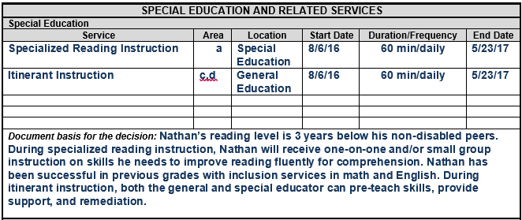
Special Education Services for Nathan
@MDE – Office of Special Education

Slide 28
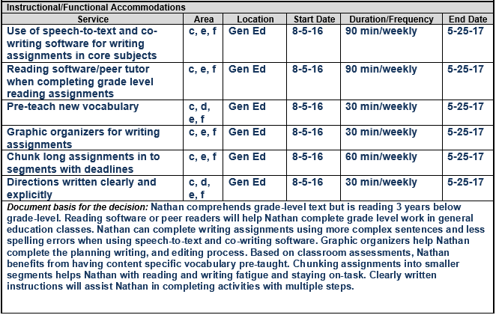
Examples of Accommodations and Modifications for Nathan
@MDE – Office of Special Education

Slide 29
Examples of Accommodations and Modifications for Nathan

Slide 30
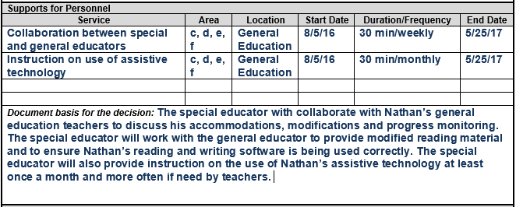
Supports for Personnel
@MDE – Office of Special Education

Slide 31
Accommodations and Modifications
How do we make sure the accommodations and modifications chosen are providing educational benefit:
Review them annually (at least).
Consider the impact on the student.
Plan on addressing the deficits that make the accommodations and modifications necessary.

Slide 32
Resources
Mississippi Department of Education-http://www.mde.k12.ms.us/docs/student-assessment/mississippi-testing-accomodations-manual.pdf
Texas Department of Education-http://tea.texas.gov/Student_Testing_and_Accountability/Testing/Student_Assessment_Overview/Accommodation_Resources/2015_Accommodations_for_Students_with_Disabilities_Taking_State_Assessments/
Colorado Department of Education- https://www.cde.state.co.us/cdesped/accommodations

Slide 33
Contact Information
M. Pleshette Smith
Instructional Specialist
mcsmith@mdek12.org
Sharon Coon
Office Director
scoon@mdek12.org
Tanya Bradley
Bureau Director
tbradley@mdek12.org
Office of Instructional Support
(601) 359-3498

