Slide 1
Bigger! by www.maine.gov
https://www.maine.gov/doe/sites/maine.gov.doe/files/bulk/prek4me/Unit6/week3/3B_%20Bigger!%20(1).pdf
Unit 6

Slide 2
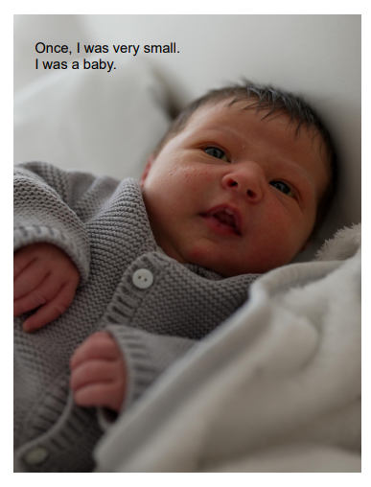
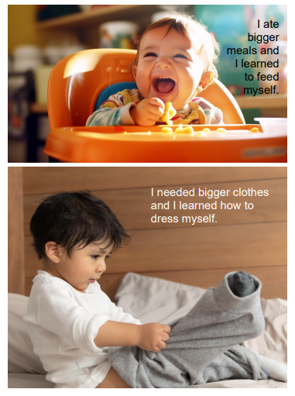

Slide 3
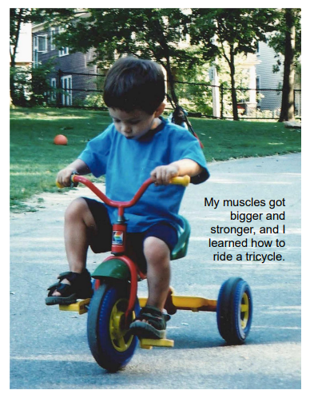

Slide 4
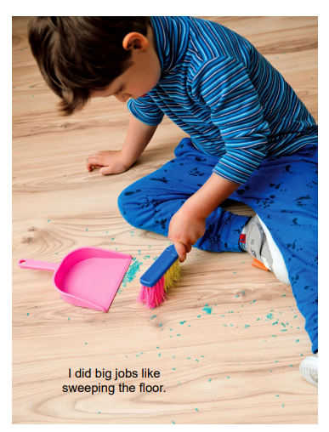
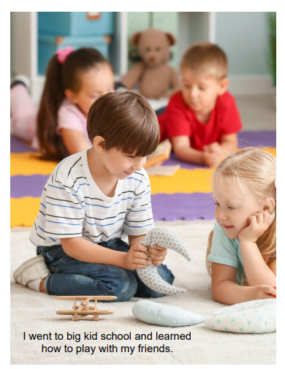

Slide 5
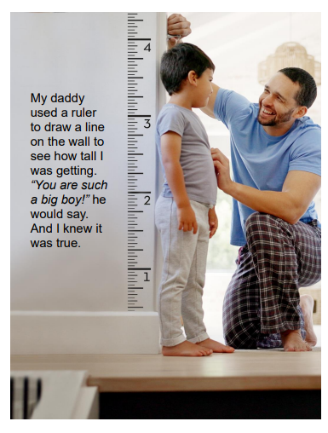

Slide 6
