Slide 1
Accountability Task Force
January 25, 2024

Slide 2
Mississippi Department of Education

Slide 3
State Board of Education STRATEGIC PLAN GOALS

Slide 4
Welcome and Introductions
First Name: | Last Name: | Organization: | Position in Organization:
Lisa Renee | LaMastus | Cleveland School District | Principal
Ryan | Kuykendall | DeSoto County | Chief Accountability Officer
Christy | Hovanetz | Foundation for Excellence in Education | External Expert
Tarrinasha | Jones | Greenville Public School District | Principal
Jermaine | Brown | Hattiesburg | Director of College & Career Readiness
Robert | Sanders | Hinds County School District | Superintendent
Raina | Holmes | Jackson County School District | High School Principal
LaToya | Blackshear | Jackson Public Schools | Director of Planning and Evaluations
Steven | Hampton | Lamar County | Superintendent
Alicia | Conerly | Lawrence County | District Instructional Specialist
Lindsay | Brett | Lee County Schools | Principal
Greg | Paczak | Madison County Schools | Director of Research & Development
Alan | Burrow | Mississippi Department of Education | Director of District and School Performance
Deborah | Donovan | Mississippi Department of Education | Data Analytics and Reporting
Paula | Vanderford | Mississippi Department of Education | Chief Accountability Officer
Tim | Scott | Mississippi Department of Education | Director of Accountability Services
William | Roberson | Oxford School District | Superintendent
Angela | Burch | Pascagoula-Gautier School District | Principal
LaVonda | White | Rankin County School District | Director of Accreditation, Accountability, and Assessment
Glen | East | State Board of Education | Board Member
Chris | Domaleski | The Center for Assessment | External Facilitator
Crystal | Bates | Wayne County High School | Assistant Principal
Lawrence | Hudson | Western Line School District | Superintendent

Slide 5
Agenda
9:00am | Welcome and Introductions
9:15am | Overview and Updates from MDE
10:00am | Break
10:15am | Accountability Performance Standards
12:00pm | Lunch
1:00pm | Accountability Priorities
3:00pm | Break
3:15pm | Follow-up and Future Topics
4:00pm | Adjourn

Slide 6
Purpose and Overview
Primary purpose is to help MDE make good decisions about the design and implementation of the state, school accountability system under ESSA
We will focus on identifying policy priorities and identifying decisions in support of those priorities that are technically defensible and operationally feasible
Feedback from the Task Force is received as a recommendation to the department

Slide 7
Ground Rules/ Group Norms
Listen actively and attentively; ask for clarification as needed
Everyone should have an opportunity to ‘be heard’ without interruption and to receive courteous feedback
Critique ideas, not people or organizations
Build on one another’s comments; work toward shared understanding
We will attempt to make decisions based on group consensus, but when necessary we will take a vote
When/ if requested do not disclose confidential information
At the end of each meeting we will prioritize topics for future meetings and discuss action items

Slide 8
Updates from MDE

Slide 9
Miss. Code Ann. § 37-17-6 (Senate Bill 2396)
Implement a single “A” through “F” school and school district accountability system
Combine state and federal accountability systems into one (federally approved) system
Establish five performance categories (“A, B, C, D, & F”) and discontinue the use of the designations of “Star, High Performing, Successful, Low-Performing, At Risk of Failing”
Incorporate a standards-based growth model
Discontinue use of QDI
Include the federally compliant 4-year graduation rate and discontinue use of HSCI
Increase standards when 75% of students are Proficient and/or when 65% of schools or districts earn a “B” or higher grade

Slide 10
Every Student Succeeds Act (ESSA) Requirements
Goals
States must establish “ambitious, state-designed long-term goals” and interim progress targets for all students and for each subgroup for: Academic achievement High school graduation English language proficiency (all students only)
Identification of Schools
The accountability system must identify at least three categories of schools: Comprehensive support and improvement schools Targeted support and intervention schools Additional schools
School Accountability
States must establish a system of meaningfully differentiating schools on an annual basis, based on the following indicators for all students and separately for each subgroup (except that English proficiency need not be disaggregated). The system must give substantial weight to each indicator. Academic achievement indicator Another academic indicator (growth, grad rate) English proficiency Additional indicator of school quality or student success
Graphic by : Foundation for Excellence in Education
Notes:
Identification of schools for school improvement is the ultimate goal of federal accountability measures to ensure that resources are allocated where they are most needed. This process starts with state-defined goals and a state-defined system of meaningful differentiation of schools.

Slide 11
Continuous Review and Improvement
Public Feedback
Accountability Task Force
Technical Advisory Committee
Commission on School Accreditation
State Board of Education

Slide 12
Updates
Ongoing push for changes to accountability from the workforce community.
Office of Inspector General (OIG) audit of accountability and school improvement.
Required submission of amendment to the ESSA State Plan
Acceleration weighting

Slide 13
Component Score Limits
The MDE has been working through the ESSA State Plan amendment process since May 23, 2023.
During this review, the USDE stated that “it is not permissible for a school to earn bonus points that exceed the maximum number of points on an indicator, based on the ESEA section 1111(c)(4)(B) requirement that indicators be valid, reliable, comparable, and statewide and the requirement regarding specific weights for each indicator under ESEA section 1111(c)(4)(C)(ii).”

Slide 14
700-Point Elementary and Middle Schools
READING | MATH | SCIENCE | ENGLISH LANGUAGE PROGRESS
Proficiency 95 pts | Proficiency 95 pts | Proficiency 95 pts | Progress to Proficiency 35 pts
Growth All Students 95 pts | Growth All Students 95 pts
Growth Lowest 25% 95 pts | Growth Lowest 25% 95 pts

Slide 15
Indicators for High Schools and Districts
READING | MATH | OTHER SUBJECTS | GRADUATION 4-YEAR | ACCELERATION | COLLEGE & CAREER READINESS | ENGLISH LANGUAGE PROGRESS
Proficiency 95 pts | Proficiency 95 pts | Science Proficiency 47.5 pts | 4-year Cohort Rate 190 pts | Performance 23.75 pts | ACT Performance 47.5 pts Or | Progress to Proficiency 50 pts
Growth All Students 95 pts | Growth All Students 95 pts | U.S. History Proficiency 47.5 pts |  | Participation 23.75 pts | ACT WorkKeys Option 47.5 pts
Growth Lowest 25% 95 pts | Growth Lowest 25% 95 pts

Slide 16
Key Findings
0 = Number of Districts whose letter grade would have changed
0 = Number of 700 point schools whose letter grade would have changed
31 = Number of 1000 point schools whose letter grade would have changed

Slide 17
Key Findings
-0.1 = Average change in total points for Districts
-0.2 = Average change in total points for 700 point schools
-12.8 = Average change in total points for 1000 point schools

Slide 18
Weighted Components Cap – Impact Data (1000 Point Schools)
 | 2023 Grade – w/ Weighted Cap
2023 Grade | A | B | C | D | F | Total
A | 87 | 9 |  |  |  | 96
B |  | 87 | 17 |  |  | 104
C |  |  | 22 | 5 |  | 27
D |  |  |  | 3 |  | 3
F |  |  |  |  | 2 | 2
Total | 87 | 96 | 39 | 8 | 2 | 232
Increased
Same
Decreased

Slide 19
Primarily High School Math Impact
5 schools had an average change of -4.1 points in acceleration
1 high school had a change in Reading all growth
1 high school had a change in Reading low growth
84 high schools had a change in Math all growth (Avg = -7.5 points)
134 high schools had a change in Math low growth (Avg = -13.9 points)

Slide 20
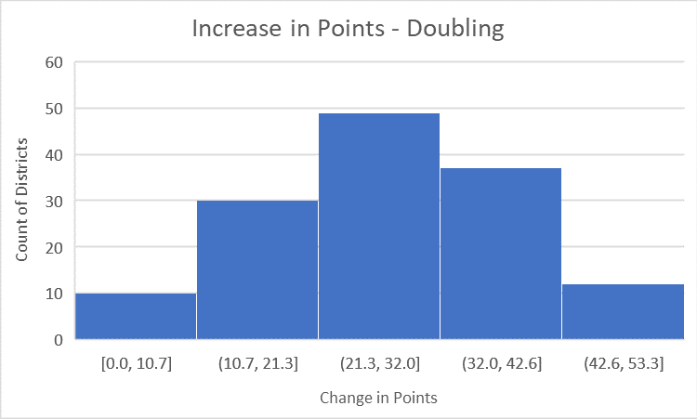
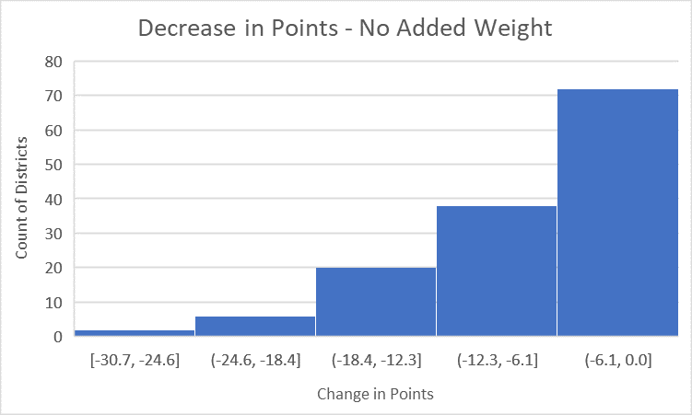
Impact to Acceleration

Slide 21
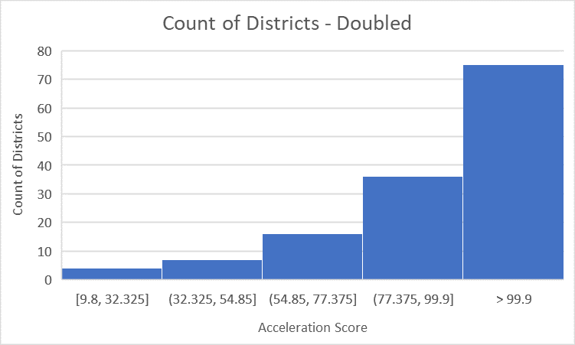
Acceleration Impact - All Doubled

Slide 22
 | Actual | Single | Double
Mean | 68.8 | 61.4 | 96.4
Median | 72 | 63.7 | 102.7
Minimum | 9.8 | 9.8 | 9.8
Maximum | 111 | 95.3 | 137.8

Slide 23
Accountability Performance Standards

Slide 24
Legislative Requirements
Standards for student, school, and school district performance will be increased when student proficiency is at seventy-five percent (75%) and/or when sixty-five percent (65%) of the schools and/or school districts are earning a grade of “B” or higher, in order to raise the standard on performance after targets are met.
Districts
2019 | 2022 | 2023
45.5% | 55.9% | 71.2%
Schools
2019 | 2022 | 2023
54.3% | 61.2% | 73.8%

Slide 25
Key Questions
What general approach does the task force recommend for establishing performance standards?
What factors should be most influential?
Should the MDE consider different approaches for weighting or combining indicators?

Slide 26
What are performance standards?
Performance standards answer the question, “What’s ‘good enough’ to achieve a designated score or rating?”
Performance standards should be operationalized as a cut-score or set of decision rules to define what is minimally acceptable.
Applies to indicators and overall performance.

Slide 27
General Approaches
Norm-referenced
Standards are based on the desired distribution of performance for schools or districts
For example: Only 10% of schools should get an “A”
Criterion-referenced
Standards are based on a performance definition or profile
For example: to get an “A,” 90% of students must be proficient or meet growth targets.
Hybrid
Combines elements of both norm and criterion-referenced approaches
The federal requirements to determine the threshold for CSI is an example of a hybrid approach.
Must include all high schools with graduation rates less than 67% (criterion)
Must be at least 5% (normative)

Slide 28
Considerations
Method | Advantages
Norm-referenced | Easy to understand and implement If a target distribution is known a norm-referenced approach ensures that result will be achieved Can fluctuate or be fixed over time by setting a baseline
Criterion-referenced | Provides clear definition of expectations for each letter grade It doesn’t enforce a certain distribution Is fixed over time, until/unless the criteria are changed

Slide 29
How do you set standards?
There is a strong tradition of setting standards for assessment that can be applied to accountability systems.
Strong approaches:
are designed to reflect policy priorities
are informed by the judgements of broad-based group of experts and stakeholders guided by relevant information, including consequences
are transparent and well documented
The defensibility of performance standards are strongly linked to the process

Slide 30
What factors are most influential?
In a strictly norm-referenced approach, the resulting distribution is most influential.
Norm-referenced approaches can differently weight internal factors or be informed by external factors (e.g., NAEP results).
In a criterion-referenced referenced approach it’s important to create school and district performance level descriptor(s) to define the target performance.
These descriptors function as a ‘rubric’ to guide judgements about school quality.

Slide 31
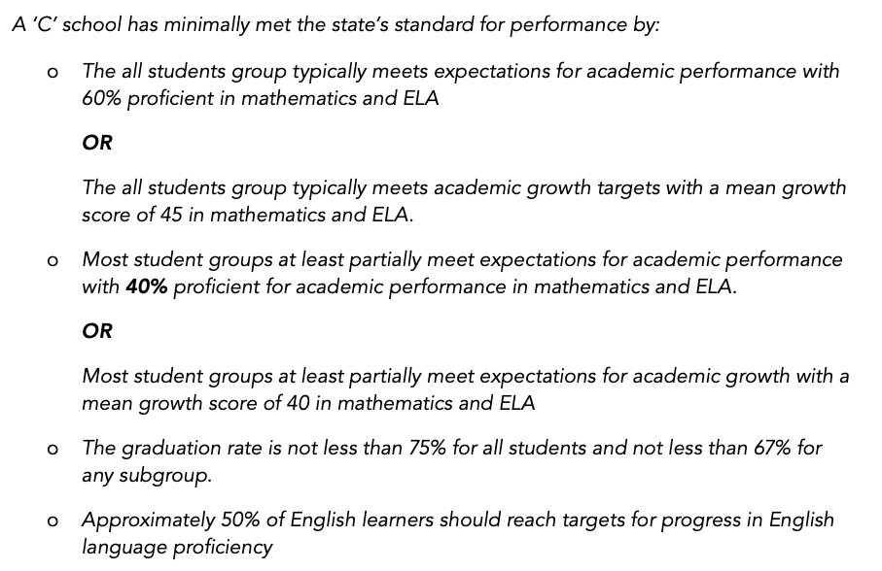
Example of a School Performance Level Descriptor (SPLD)
Example from: Domaleski, C., D'Brot, J., Keng, L., Keglovits, R., Neal, A., (2018). Establishing Performance Standards for School Accountability Systems. Council of Chief State School Officers, Washington, D.C.

Slide 32
Combining Indicators
ESSA requirements:
With respect to the academic achievement, growth, progress in English language proficiency, and grad rate indicators, afford “substantial weight to each such indicator; and in the aggregate, much greater weight than is afforded to the indicator[s] [for school quality and student success].”

Slide 33
Approaches for Combining Indicators
Method | Description | Example
Compensatory | Higher performance on one indicator can offset performance on another. | Index or weighted composite
Conjunctive | Performance on ALL indicators provides overall decision | NCLB methods (i.e., all groups must be proficient in all grades and content areas)
Disjunctive | Performance on ANY indicator provides overall decision | Menu approach (i.e., show college or career readiness by demonstrating one of the following….)
Profile | Define specific patterns regarded as sufficient for entry or exit into a classification | IF THEN approaches. IF proficiency meets target THEN growth expectation is lowered

Slide 34
Considerations
To what extent does the weighting structure (numerical or otherwise) reflect policy “weights”?
How will the system respond to missing indicator(s)?
Is the weighting structure understandable and meaningful to users of the system?
To what extent do resources align with requirements to support identified schools?

Slide 35
Discussion
Using the form provided please provide your feedback on the following questions:
What general approach do you recommend for establishing performance standards?
What factors should be most influential?
Should the MDE consider a different approach for weighting or combining indicators?
5-10 minutes for individual work
20 minutes for small group discussion
20 minutes for full group discussion

Slide 36
Accountability Priorities

Slide 37
Proposed Changes to Accountability (LEAs)
In general, LEAs did not want major changes to the model.
Concerns about decreased weighting in growth
Most liked the idea of menu of options
ASVAB
Grad Options
Reduction in Chronic Absenteeism
ACT/WorkKeys

Slide 38
Proposed Changes to Accountability (Workforce Group)
Accelerate Mississippi, Camgian, CREATE Foundation, Ingalls Shipbuilding, Mississippi Economic Council, Mississippi Energy Institute, National Guard Association, Nissan, PATH, State Workforce Investment Board, University of Mississippi Medical Center, and Wayne-Sanderson Farms
The group identified several opportunities for growth that would better prepare today’s graduates for postsecondary education and employment:
Leadership development
Teamwork
Organization and time management
Attendance and timeliness
Critical thinking and logic
Communication
Public speaking
Interpersonal skills
Life skills
Emotional intelligence

Slide 39
Today’s Discussion
We’ll start with a high level scan of how other states are approaching accountability.
Then, we’ll do a deeper dive to consider a broader range of school-quality indicators that could be considered.
Our purpose is to prompt discussion about ideas and promising practices we should explore further at future meetings.

Slide 40
ESSA Required Indicators
Meaningfully differentiate the performance of schools based on:
Academic achievement
Growth or other academic indicator
Progress in achieving English language proficiency
School Quality/Student Success
Graduation Rate (High Schools)
All indicators in the aggregate must have a greater weight than the school quality student success indicator

Slide 41
Academic Achievement
Academic achievement, as measured by proficiency on the annual assessments required under subsection (b)(2)(B)(v)(I).
This provision requires assessments in mathematics, reading/ language arts, and science that are 1) the same for all schools 2) aligned to state standards and 3) of adequate quality (operationalized by peer review)
What does this mean in practice?
Districts and schools cannot select another test to use for accountability instead of the state approved test.

Slide 42
Other Academic Indicator
High Schools
At the state’s discretion, student growth as measured
by approved annual assessments.
Elementary/ Middle Schools:
Student growth as measured by approved state assessments OR
Another valid and reliable statewide academic indicator that allows for meaningful differentiation in school performance.

Slide 43
School Quality Student Success
For all public schools in the State, not less than one indicator of school quality or student success that
allows for meaningful differentiation in school performance
is valid, reliable, and comparable
May include
student engagement
educator engagement
student access to and completion of advanced coursework
postsecondary readiness
school climate and safety
any other indicator the State chooses that meets requirements

Slide 44
Graduation Rate
For public schools in the state the four-year adjusted cohort graduation rate
At the state’s discretion, the extended-year adjusted cohort graduation rate
Extended year rate may be used in addition to but not in place of the four-year rate

Slide 45
Progress in English Language Proficiency (ELP)
Progress in achieving English language proficiency as defined by the state and measured by assessments in subsection (b)(2)(G)
In each of grades 3-8 and in the 9-12 grade band
Progress should be based on a state determined timeline
Note progress to proficiency rules out strictly norm-based growth approaches
Based on approved ELP assessments that are aligned to states’ English language proficiency standards.

Slide 46
How have states defined academic achievement?
Proficiency level summaries (benchmark approach): percent proficient for each content area, or combined over multiple content areas: Approximately two-thirds of the states use this approach.
Proficiency Index: Create index that combines information from all proficiency levels - gives credit for improvement above and below a single proficiency benchmark: Approximately one-third of the states use this approach.
For example:
Level 1=0, Level 2=.5, Level 3=1, Level 4=1.5.
Assign each student a value and aggregate for groups and schools.
Note, ESSA does not permit using average scale score. The approach must be closely coupled with proficiency.

Slide 47
Common Growth Models
Model | Key Question
Gain Score | What is the magnitude of progress on a vertical scale?
Growth to Standard | Is the student’s progress ‘on-track’?
Categorical (Value Table) | Has the student transitioned from one performance category to another?
Growth percentile | How does the student’s growth compare to his or her ‘academic peers’?
Regression or Value-added* | Controlling for selected factors, has the student grown more or less than expected?
* Value-added is more a verb than a noun, it describes a use-case intended to isolate effects, which can be applied to multiple models.

Slide 48
What models are states using for accountability?
Growth Model | Count | States
Student Growth Percentiles | 23 | AZ, CO, DC, GA, HI, IA, IN, MA, MD, MI, NV, NH, NJ, NM, NY, OR, RI, SD, UT, VT, WA, WI, WY
Value-Table | 12 | AK, FL, IN, KY, ME, MN, MS, NE, OK, TN, VA, WV
Growth to Standard | 10 | AZ, CT, ID, IN, KY, LA, MI, NV, SD, UT
Value Added | 9 | AR, LA, MO, NM, NC, OH, PA, SC, TN
Gain Score | 3 | AL, ND, TX
Other | 3 | DE, IL, MT
States may be listed more than once if they use multiple models.
Only one state does not use growth in their ESSA accountability system: KS. Instead they use an improvement measure.
Data Quality Campaign (January, 2019) Growth Data, It Matters and It’s Complicated

Slide 49
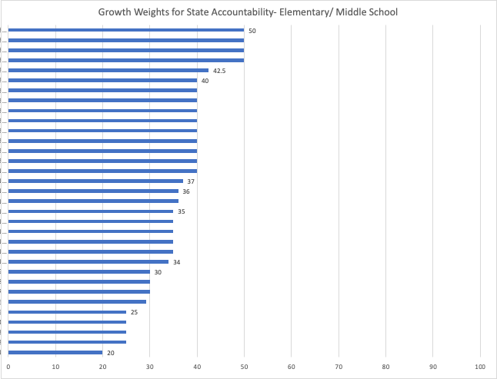
What weights do states assign to growth?

Slide 50
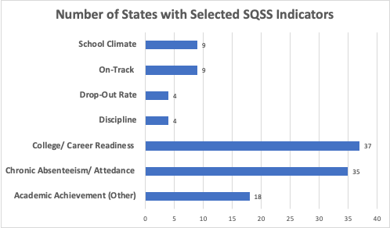
What approaches are states using for SQSS?

Slide 51
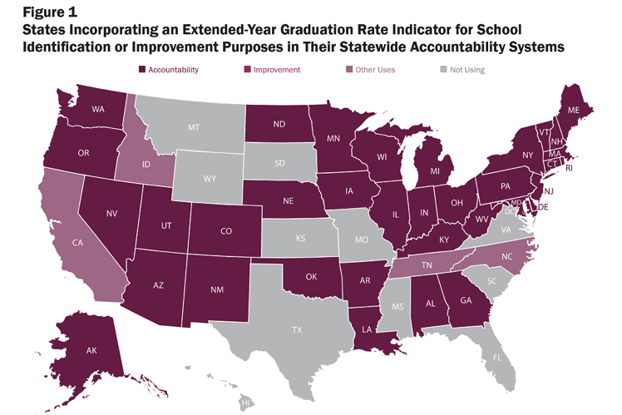
States Using Extended Year Graduation Rate
Source:
Kostyo, S., Cardichon, J., & Darling-Hammond, L. (2018). Making ESSA’s equity promise real: State strategies to close the opportunity gap: Implementing an Extended-Year Graduation Rate (research brief). Palo Alto, CA: Learning Policy Institute.
Retrieved from: https://learningpolicyinstitute.org/product/essa-equity-promise-extended-year-grad-brief

Slide 52
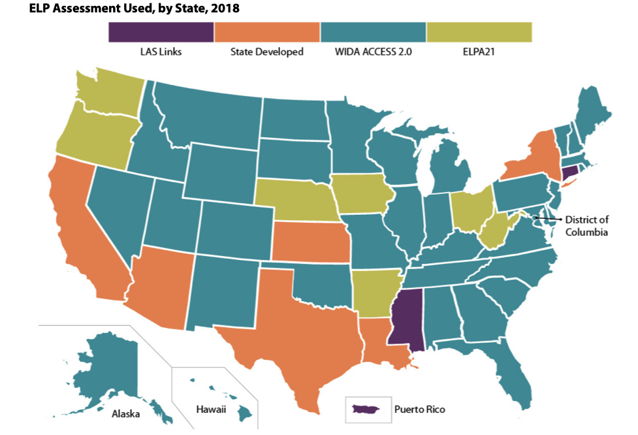
EL Assessments by State
Source:
Villegas, L. & Pompa, D. (2020). The Patchy Landscape of State English Learner Policies Under ESSA. Migration Policy Institute. Retrieved from: https://www.migrationpolicy.org/sites/default/files/publications/ESSA-Compendium-Final.pdf

Slide 53
Broader “Measures that Matter” for Schools
There are a wide range of factors associated with school quality outside of what is traditionally included in accountability (i.e., mostly outputs).
Including a broader array of indicators can better fulfill the promise of accountability, including signaling what outcomes are valued and providing information on those outcomes.

Slide 54
Varying Frameworks, Conceptualizations, and Labels
•21st Century Skills (NRC, 2012)
•Deeper Learning Skills (Stecher, Hamilton, 2014)
•Dispositions and Ethics (Pack, 2022, October 18)
•Durable Skills (Sparks, 2023, November 21)
•Employability Skills (Horvathova, 2020)
•Executive Function (Jones, Lesaux & Barnes, 2022)
•Habits of Mind (Costa and Kallick, 2008)
•Human Skills (Lewis, 2021)
•Interdisciplinary Skills (Foster, 2023)
•Non-Cognitive Skills (Jones, Lesaux, & Barnes, 2022)
•Transacademic Skills (NCIEA, 2015)
•Transformative Competencies (OECD, 2019)
•Transportable Skills (PLTW)
•Transferable Skills
•Translatable Skills
•SEL Skills (CASEL)
•Self-Management Skills
•Skills for the Future
•Soft Skills
•Student Success Skills (PBL Works & NCIEA, 2020)
•Work Study Practices (NHDOE, 2014)
“Jingle Jangle” Problem
Credit to W. Chris Brandt who created this slide.

Slide 55
Social and Emotional Learning (Non-Academic Skills)
“Social and emotional learning (SEL) has often been used as an umbrella term to represent a wide array of non-academic skills that individuals need in order to set goals, manage behavior, build relationships, and process and remember information. These skills and competencies develop across our lives and are essential to success in school, work, home, and community. Generally speaking, this set of skills can be organized into three interrelated areas: cognitive, social, and emotional.” https://easel.gse.harvard.edu/taxonomy-project
Social and emotional learning (SEL)
21st century skills
Transferable, durable, soft, or non-cognitive skills
Global skills and competencies
Other…

Slide 56
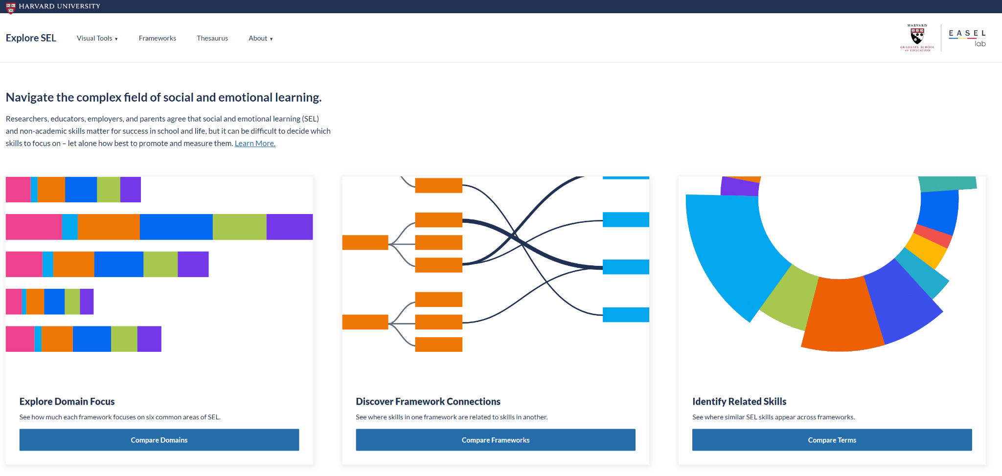
SEL is a complex field with many frameworks and inconsistent use of terms.
http://exploresel.gse.harvard.edu/
Notes:
It’s a complex field--we’ve picked some prominent examples
discussion of this broad non-academic domain lacks clarity about what we mean and is beset by dilemmas about how best to measure and promote skills in this area. Underlying this challenge, and in some ways compounding it, is the fact that the field more generally is structured around a large number of organizational systems or frameworks that often use different or even conflicting terminology to talk about a similar set of skills.

Slide 57
Example 1: CASEL Wheel
One SEL framework, known to many as the “CASEL wheel,” helps cultivate skills and environments that advance students’ learning and development
Self-awareness
Self-management
Social awareness
Relationship skills
Responsible decision-making
https://casel.org/fundamentals-of-sel/what-is-the-casel-framework/

Slide 58
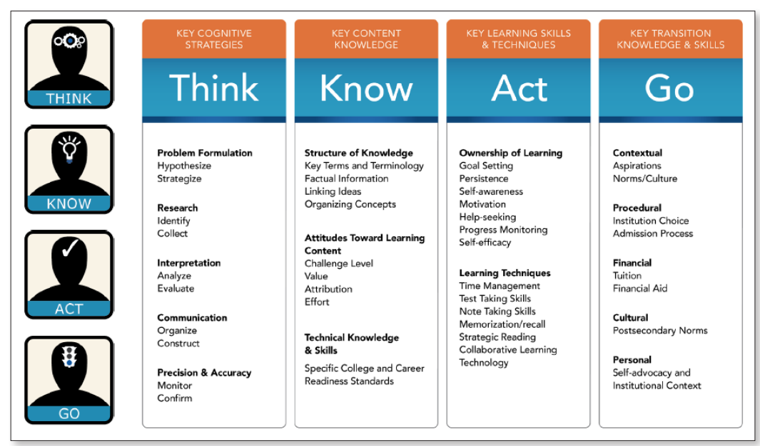
Example 2: Conley’s Four Keys Framework
https://files.eric.ed.gov/fulltext/EJ794245.pdf

Slide 59
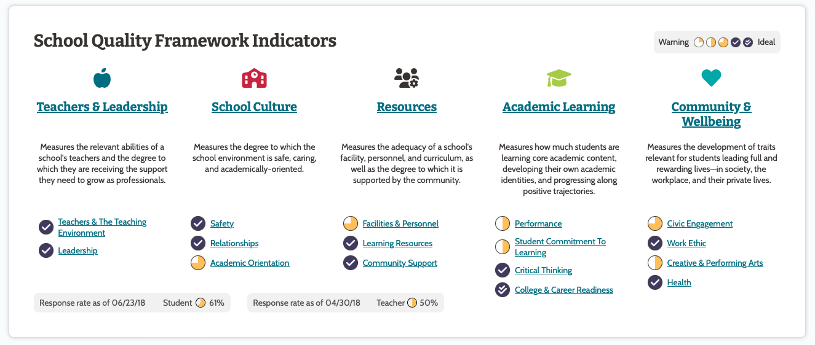
Example 3: MCIEA Dashboard

Slide 60
A Note of Caution: Campbell’s Law
The more any quantitative social indicator is used for decision-making, the more subject it will be to corruption pressures and the more apt it will be to distort and corrupt the process it is intended to monitor.

Slide 61
Discussion
Use the form provided to share your feedback about, “What should we prioritize and why?”
Considerations:
Will the indicator meet ESSA requirements?
Should the indicator be included in the state accountability system, used for reporting only, or something else?
To what extent do schools influence this indicator?
To what extent are there credible measures for the indicator?
To what extent is the indicator potentially corruptible or susceptible to Campbell’s Law?
10 minutes for individual work
20 minutes for small group discussion
20 minutes for full group discussion

Slide 62
Follow-Up and Future Topics

Slide 63
Before we adjourn…
What’s one thing we covered today that you want to emphasize and/or request we follow-up on?
What’s a topic or issue we have not covered you’d like the task force to address in the future?

