Slide 1
Selecting Books that Honor Diversity

Slide 2
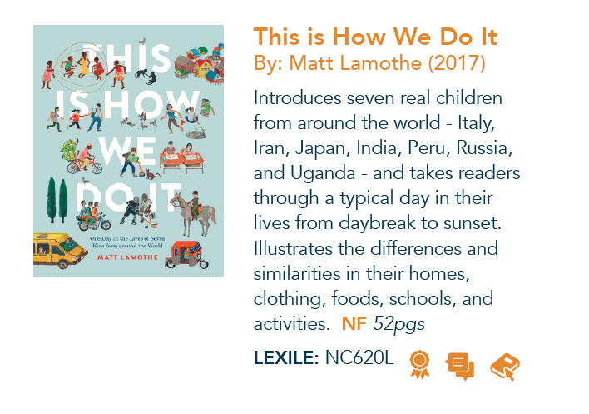
K-1st grade Equipped: Mississippi Book List for All
Review the selected text from the Equipped Book list located at the top of the slide.
In the pink boxes, explain how the selected text will be a mirror, window, and sliding glass door for your students.

Slide 3
2nd grade Equipped: Mississippi Book List for All
Review the selected text from the Equipped Book list located at the top of the slide.
In the pink boxes, explain how the selected text will be a mirror, window, and sliding glass door for your students.

Slide 4
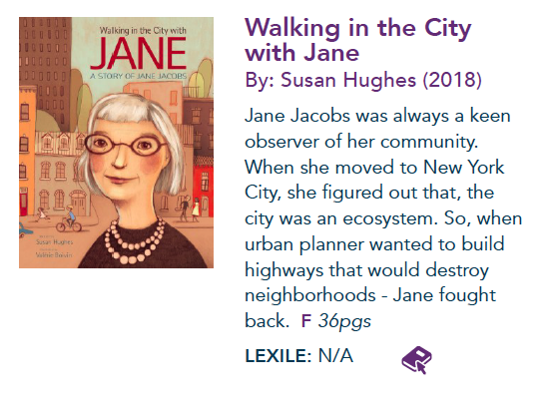
3rd grade Equipped: Mississippi Book List for All
Review the selected text from the Equipped Book list located at the top of the slide.
In the pink boxes, explain how the selected text will be a mirror, window, and sliding glass door for your students.

Slide 5
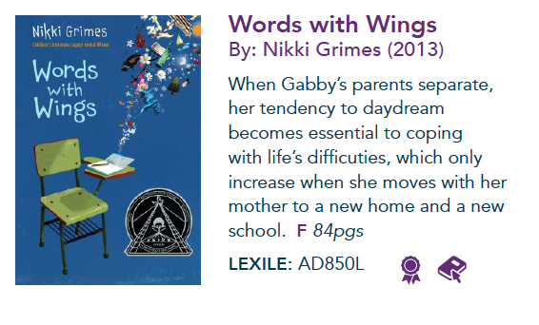
4th grade Equipped: Mississippi Book List for All
Review the selected text from the Equipped Book list located at the top of the slide.
In the pink boxes, explain how the selected text will be a mirror, window, and sliding glass door for your students.

Slide 6
5th grade Equipped: Mississippi Book List for All
Review the selected text from the Equipped Book list located at the top of the slide.
In the pink boxes, explain how the selected text will be a mirror, window, and sliding glass door for your students.

Slide 7
6th grade Equipped: Mississippi Book List for All
Review the selected text from the Equipped Book list located at the top of the slide.
In the pink boxes, explain how the selected text will be a mirror, window, and sliding glass door for your students.

Slide 8
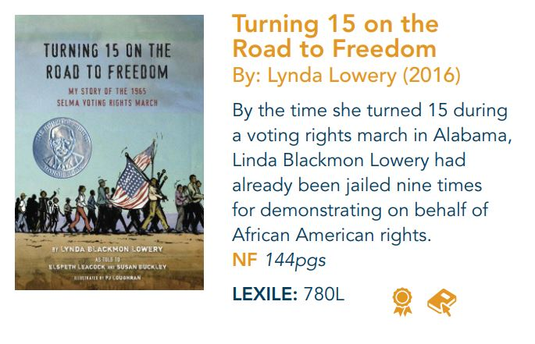
7th-8th grades Equipped: Mississippi Book List for All
Review the selected text from the Equipped Book list located at the top of the slide.
In the pink boxes, explain how the selected text will be a mirror, window, and sliding glass door for your students.

Slide 9
High School Equipped: Mississippi Book List for All
Review the selected text from the Equipped Book list located at the top of the slide.
In the pink boxes, explain how the selected text will be a mirror, window, and sliding glass door for your students.

